Slide 1
Autonomous pipetting made affordable and accessible
Notes:
Schu

Slide 2
Who We Are
Brian Schuster is an MSEE candidate with past professional experience at several aerospace/defense companies. Professional interests include digital signal processing hardware implementations, EMI/EMC test design, and pattern recognition/machine learning. Also collects tea and is an unapologetic D&D nerd.
Brian Yuen is a College Senior interested in: Analog circuit design, technology consulting, startups, and leadership. 4 summers of work experience at a semiconductor startup designing analog circuits. 1 summer of experience at a complex plasma lab. In my off time, I enjoy traveling the world and eating anything that I come across.
Notes:
Schu and Yuen

Slide 3
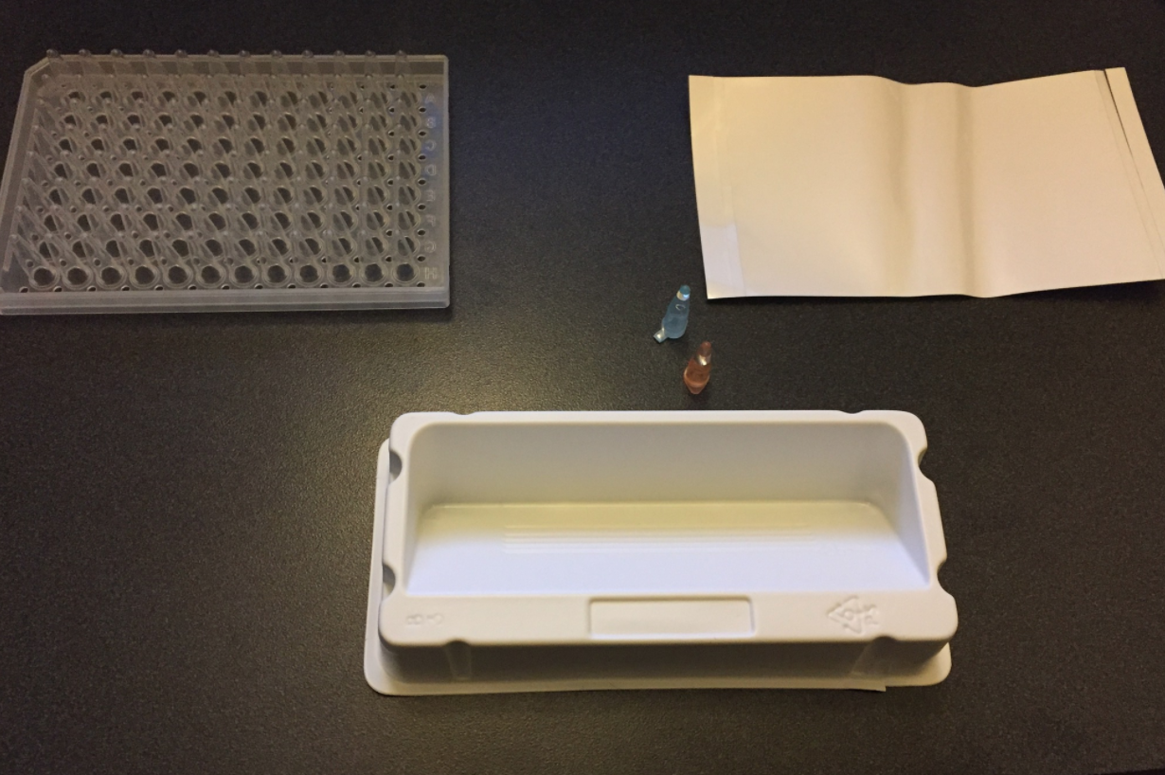
Market Research
Notes:
Yuen
Some labs don't do mass production with pipetting

Slide 4
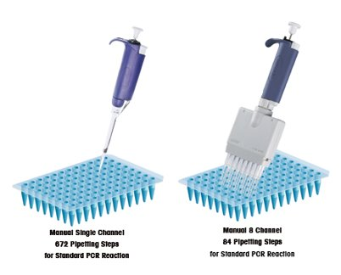
Concept/Demand
Pipetting operations are frequently required in medical research
eg. PCR (DNA replication)
They are also repetitive, time-consuming, and prone to human error
Ripe for automation!
Manual Single Channel
672 pipetting steps for standard PCR reaction
Manual 8 Channel
84 pipetting steps for standard PCR reaction
http://anachempipettestipsservice.blogspot.com/2010/09/multichannel-pipettes-easy-way-to.html​
Notes:
Yuen
Wasting skill labor on labor-intensive tasks.

Slide 5
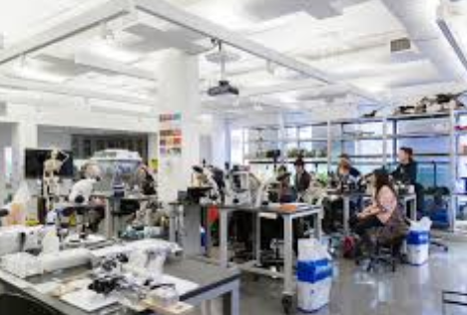
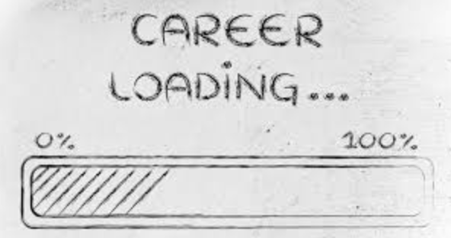
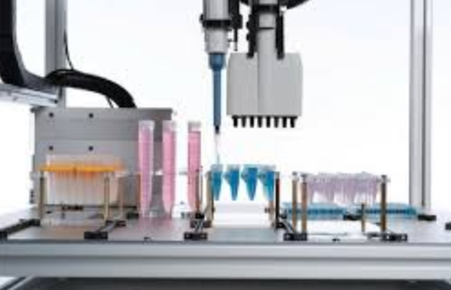
Market
20
113300 grads
453200 students
22660 labs
$24710
6.87%
Notes:
Yuen
Goal is to penetrate with low-cost model. ("be the budget option")

Slide 6
$683 Million
$17
Million
Notes:
Yuen

Slide 7
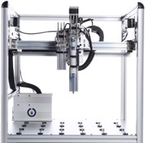
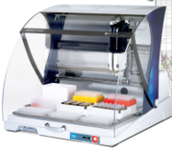
Competition
Manufacturer​ | Hamilton Labs​ | Gilson​ | Opentrons​
Model​ | Microlab NIMBUS​ | qPCR Assistant​ | OT One-S​
Price​ | $15,000​ | $4,000​ | $3,000​
Notes:
Schu

Slide 8
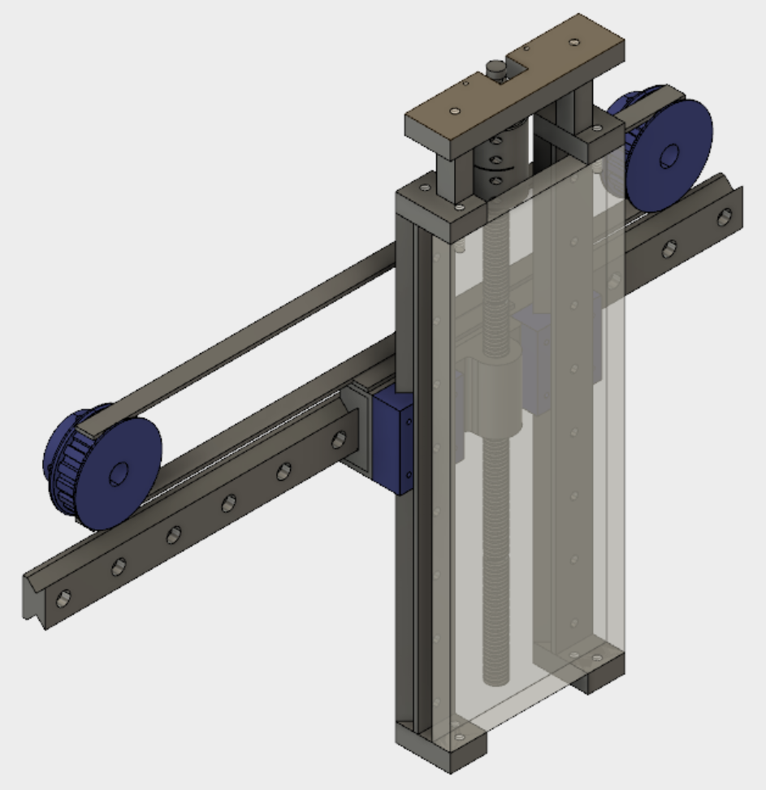
Our Idea
Simple 3-axis track with stepper motor controls
Large machinable front plate on which stock pipettes can be mounted
Linear actuator motors for operating pipette/ejecting tips
Gear/belt system for adjusting pipette volume
Notes:
Schu
Mention easily configurable software.

Slide 9
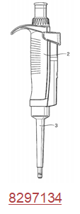
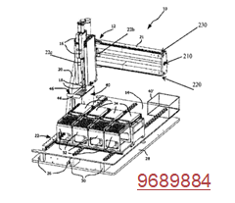
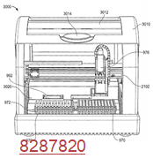
Patents/IP
Patents already exist for manual micropipettes, pipetting robots, and multi-axis pipetting tracks.
No patents yet for autonomous actuation of traditionally manual pipettes.
Among others...
Notes:
Schu

Slide 10
Business Model
Prototypes to be tested at the Wilmer Eye Insitute and the Bloomberg School of Public of Health.
Direct-To-Customer Sales of units via online store
Eventually develop adapters for different pipette manufacturers
Target small labs and universities
Possible subscription software support
Develop tailored routines for customers
Notes:
Yuen

Slide 11
2-Year Required Funding: $801,000
2 Engineers full-time: $400,000
1 Marketing consultant part-time: $100,000
Materials for first 100 units: $100,000
Machining for 100 units: $60,000
Office Space: $48,000
R&D Parts: $48,000
Office Supplies & Tools: $15,000
Travel: $30,000
Notes:
Schu

Slide 12
[Supplement] Additional Relevant Patents
9689884
9678095
9347586
9278349
8580197
8372356
8297134
8287820
6910395
232129
4098125
9393561
8661920
7434484
7125519
5906795
5406856
4830832
4470317
4261205
0314295
0136888
1060909
0261469
0704522

Slide 13
Market Sources
https://nces.ed.gov/fastfacts/display.asp?id=37 (major breakdown)
http://opentrons.com/?gclid=Cj0KCQiAmITRBRCSARIsAEOZmr6n7d01omkKFkl-odxjcJtcDrhdRw2UJQAmh5yxG0yqqTjZcs1-A6saAmhfEALw_wcB
https://online-shop.eppendorf.us/US-en/Automated-Pipetting-44509.html#goto-Automated-Pipetting-WebPMain-44509
http://www.gilson.com/en/pipetmax

Slide 14
Expense Breakdown
Expense | Units | Cost
Full Time Engineer | 2 | $400,000/2yr
Build Parts | 100 | $100,000/2yr
Machining Costs | 100 | $60,000/2yr (1)
Office Space | 2 years | $48,000/2yr (2)
Marketing Consultant | 1 | $100,000/2yr
R&D |  | $48,000/2yr (3)
Office Equipment |  | $15,000 (4)
Travel |  | $30,000 (5)
Total: |  | $801,000/2yrs
(1) Machining Costs: $30/hr * 2.5burden (outsourced) * 8 man-hours/build * 100 units = $60,000
(2) Office Space: $1/sqft/month * 2000sqft * 24 months = $48,000
(3) $1000/month per engineer
(4) 3 PCs + 1 3d printer + desks/chairs/etc + tools = 1500*3 + 5000 +500 + = 15,000
(5) Travel: 6 trips/yr * 2 engineers * (300/ticket + 500 lodging + 100 per diem * 3 days + 100 transportation) = 28,800

