Slide 1
Uvin
UNIVERSALLY VIGILANT INSOLE

Slide 2
TEAM Uvin
Vamsi Reddy
Xiaodong Huo
Andy Sun

Slide 3
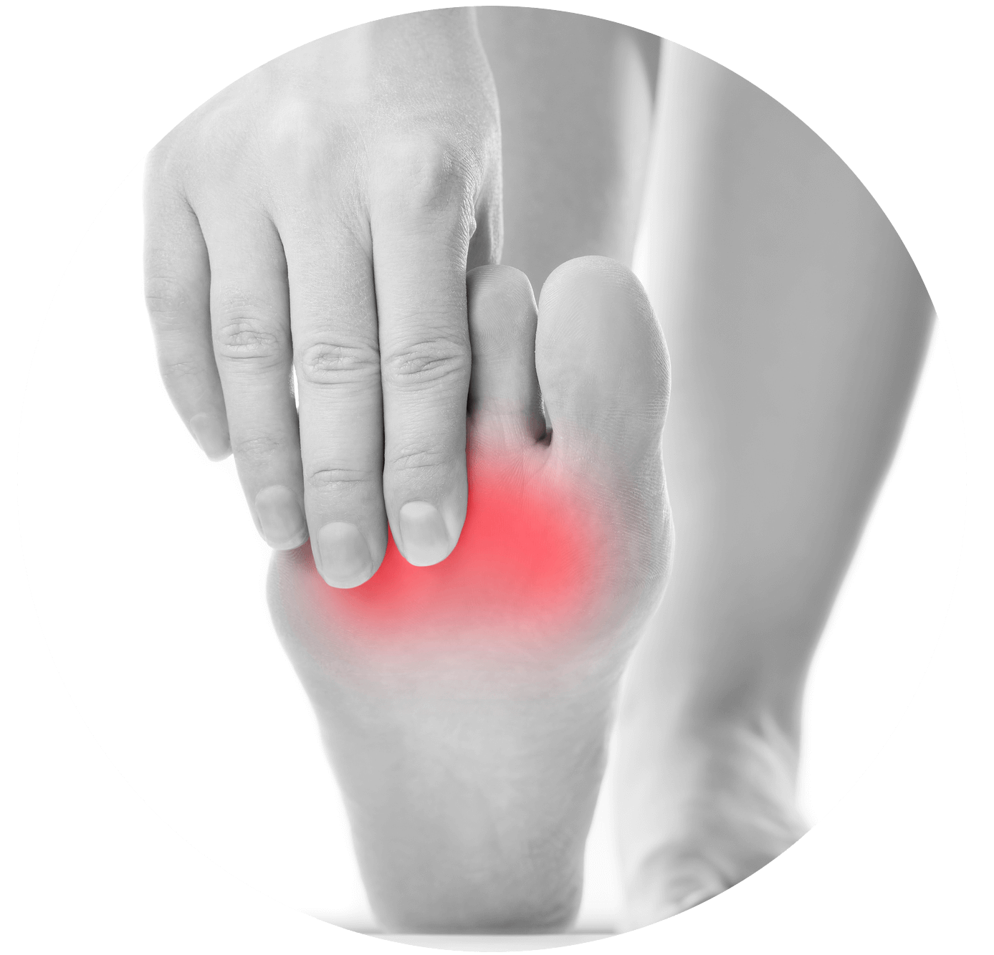
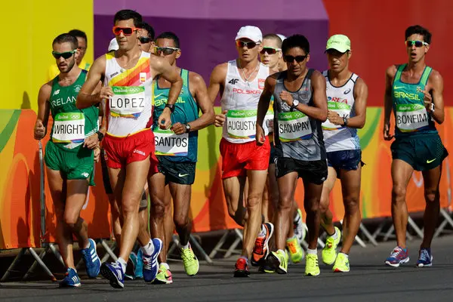
WHY INSOLE?
Improper pressure distribution causes irregular gait patterns and eventually pain
Casual Walking
Improper Pressure
Racewalking in Olympics

Slide 4
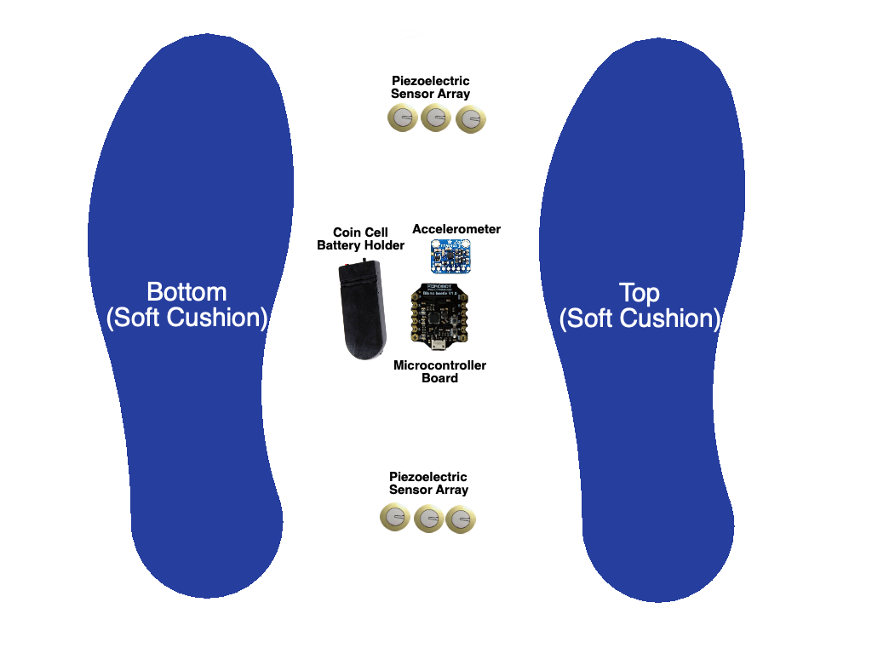
Uvin INSOLES
Uvin Insole in a shoe
+
+
Layers of Uvin Insole

Slide 5
Uvin INSOLES
Premium Features:
Swing and Stance phases pressure variance
Pressure range distribution (heel to toe)
Mutual Insole communication
Relative Pressure balance (Left Foot/ Right Foot)
Overall Activity Pressure Profile
In-shoe Alerting system
Layers of Uvin Insole

Slide 6
DESIGN ASPECTS
Compartments:
Forefoot PSZ
Central Control Unit
Backfoot PSZ
PSZ – Pressure Sensing Zones

Slide 7
WORKING MECHANISM
Sensors collect reading
Data moved to master sole
Master sole analyzes data
User walks
Data sent to device
Yes
Is the movement proper?
No
Vibration motors activated
Notes:
Gif of walking
(improper gait)
Gif of pain in foot
Pressure identification

Slide 8
MARKET SCOPE
Source: www.grandviewresearch.com

Slide 9
COMPETITORS
FeetMe Sport $ 250
E-vone $150 (plus $20 per month-alarm service)
Salted Venture $ 269
Boltt Sports Technologies $41.88
Digitsole $80
They lack:
Mutual Insole communication
In-shoe Alerting system
Notes:
The smart shoes market size was valued at $115.3 million in 2018 and is expected to reach $223.4 million by 2026, registering a CAGR of 9.1% from 2019 to 2026.
https://www.nanalyze.com/2019/02/smart-shoes-digitally-connected/
1. Over all pressure distribution profile
2. Phase specific pressure distribution
3. Time of pressure from back go front part of the feet.
For the market, we should highlight the drawbacks of existing models and patents in terms of the four novel properties of our insole
When we talk abou the maket - Model name/ Company name - Weight - Continous monitoring- Overall pressure distribution and the most important would be the high speed data transmission and storage
4. Customized calibration of pressure distribution to make the system adaptive and robust

Slide 10
We need $778,000
Expense | Total Price
Manufacturing Cost (5000 units at 70% of BOM) | $ 263,500
Office and Site Management | $ 50,000
RND and Product Development | $ 10,000
IP and Marketing | $ 50,000
Engineers and Staff | $ 400,000
Additional Expenses | $ 5,000
Total | $ 778,500.00
Optimized Finances for One year:

Slide 11
WITHIN THE SEED-STAGE
Future Work :
Swing and Stance phases pressure variance
Developing a Mobile App to attract customers
Creating versatility in sizes and colors
Pre-market testing with 100 volunteers
Feedback review mechanism for the product
Uvin Branding and Product Launch

Slide 12
Uvin
UNIVERSALLY VIGILANT INSOLE
Let’s win every walk of life with Uvin
Thank you !

