Slide 1
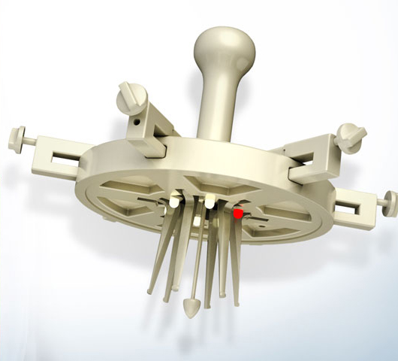

Slide 2
Cost: 35000-150000$
Amount: 650000 (US)
Recuperation : 2-6 weeks
Sources:
www.spine-health.com
www.micromarketmonitor.com
www.mordorintelligence
http://health.costhelper.com

Slide 3
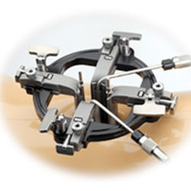
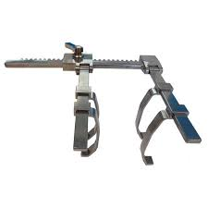
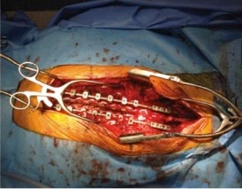
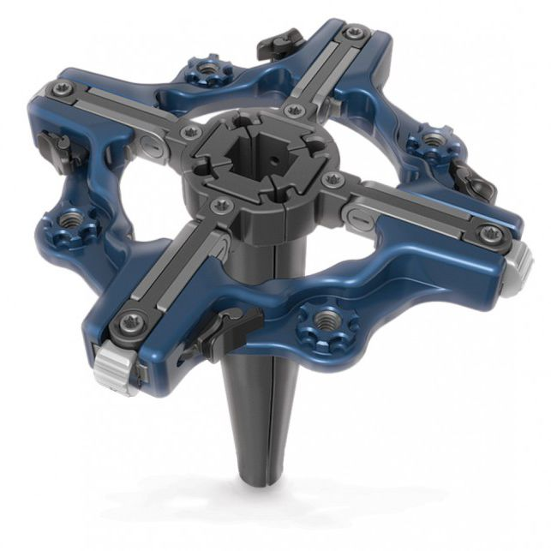
Current solutions:
Precision spine – cons:
Made from metal (non-radiolucent)
no-light
no-camera
Only four pins (access problem when need to rotate)
High cost(12000$)
Ansabere – cons:
Leaves large scar on the back after surgery
Made from metal (non-radiolucent)
no-light
no-camera
RTI surgical– cons:
Made from metal (non-radiolucent)
no-light
no-camera
Only four pins (access problem when need to rotate)
High cost(15000$)

Slide 4
surgeFREE retractor advantages:
Radiolucent
LED illumination
Built in HD camera
Retraction & angle control
6 ribs/pins (accurate access)
Low-cost

Slide 5
How would we make money
from the device:
Each unit will cost 1300$ (mass production)
One unit will be sold at 2800$
1500$ * 1000 units per year (at least) = 1.5M $
Business model:
Cooperation with orthopedic surgeons & direct sell to hospitals & private clinics

Slide 6
Product timeline:
TASK | TIME
Initial design (layout) | 1 month
Prototype manufacturing | 1 month
Assembling | 1 week
Testing | 6 months
Marketing timeline:
TASK | TIME
Designated marketing(visits in hospitals) | 2 months
Exhibition in MEDICA 2018 | 1 week
Exhibition in FIME 2018 | 1 week
Cooperation with 1 or 2 orthopedic surgeons

Slide 7
HOW MUCH MONEY DO WE NEED FOR THIS PROJECT:
PART | COST
Engineering/MFG work (10 months * 30K) | 300K NIS
Patent attorney | 50K $
Regulations | 50K $
Flights + general expenses(such fair fees) | 60K $
Initial investment (production) | 30K $
Total = 300000 $

Slide 8
REGULATIONS
NUMBER | CLASS | LINK
FDA 878.4800 | 1 | https://www.accessdata.fda.gov/scripts/cdrh/cfdocs/cfpcd/classification.cfm?ID=5502
FDA 878.4800 | 1 | https://www.accessdata.fda.gov/scripts/cdrh/cfdocs/cfpcd/classification.cfm?ID=5670
SIMILAR PATENTS
NUMBER | LINK
US4747394A | https://patents.google.com/patent/US4747394
US5363841A | https://patents.google.com/patent/US5363841

