Slide 1
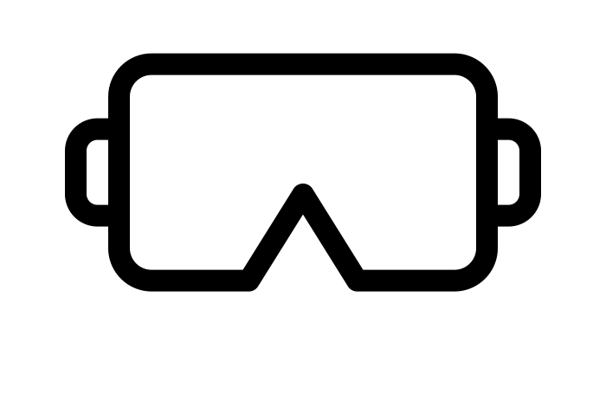
Sia Intuitive
Virtual Reality Tools for Therapy
Sia
Nikhil Davé, Kirby Gong, Yesenia Salazar

Slide 2
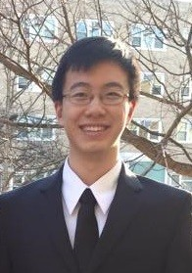
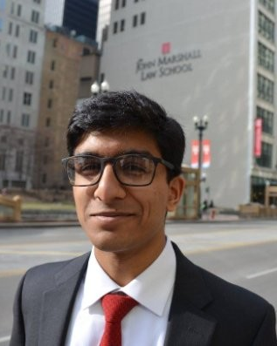
About Us
Nikhil Davé
Current BME MS Candidate, research focus in computer integrated surgical systems.
Completing thesis work at Tsinghua EE.
Kirby Gong
BME MS candidate researching predictive models for delirium and hospital readmissions
Past technical work at Epic Systems, Johnson & Johnson, and Baxter
Yesenia Salazar
Third year undergraduate majoring in computer engineering and robotics
Research experience in natural language processing and computer vision
Notes:
-read off stat
-explain exposure therapy
-explain benefits (lower refusal, equivalent or better outcomes, higher patient satisfaction)
-touch on disadvantages

Slide 3
Problem: Therapy for Disorders
Autism, Anxiety, Panic Disorders affect upwards of 10 million people
Treatment with exposure therapy
VR shown to be beneficial
Less refusals
Symptom outcomes
Patient satisfaction
But expensive, difficult to implement
https://www.inquirer.com/health/millennial-health-blue-cross-blue-shield-mental-health-20190424.html
Notes:
-read off stat
-explain exposure therapy
-explain benefits (lower refusal, equivalent or better outcomes, higher patient satisfaction)
-touch on disadvantages

Slide 4
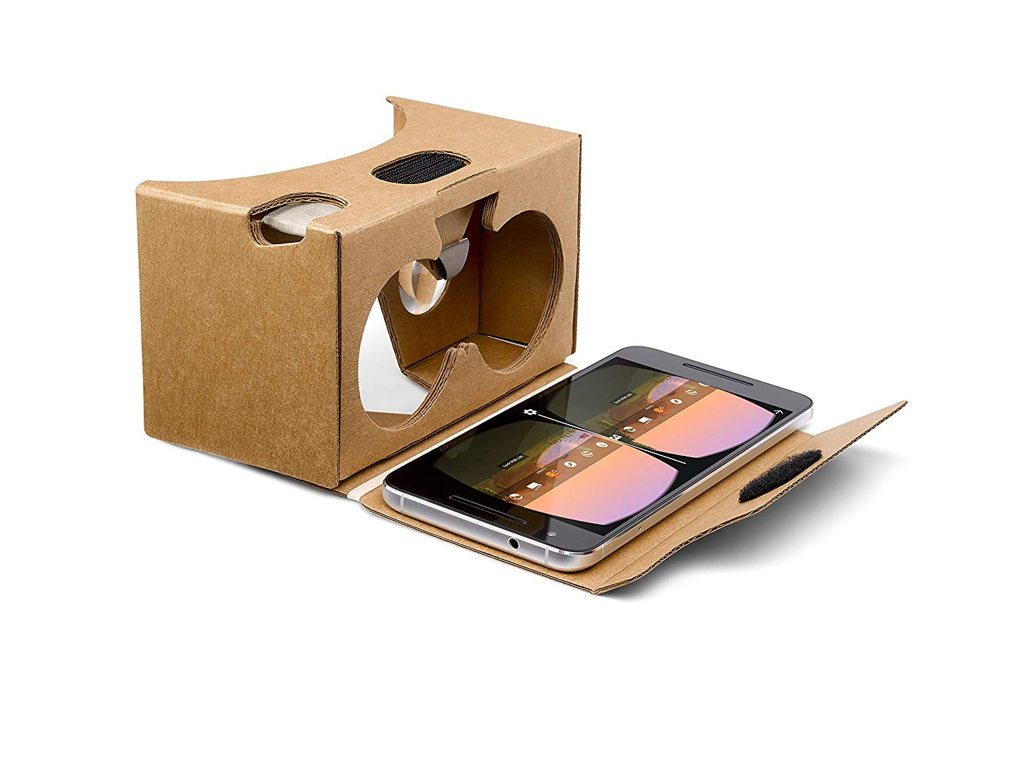
Solution: Virtual Reality Phone Application
Using SmartPhone VR technology
Google Cardboard goggles
Download app
Pick a scenario
Change settings
Get started!
https://images-na.ssl-images-amazon.com/images/I/81BKTMewQWL._SL1500_.jpg
Notes:
We are creating a new, simple VR application, to be run from smartphones. Smartphones are already ubiquitous, and all that would be required beyond that to get a good VR experience is a set of goggles, the cheapest of which run about $5. Our user could download the app, pick a scenario, modify its intensity, and place their phone in the goggles to begin the VR experience.

Slide 5
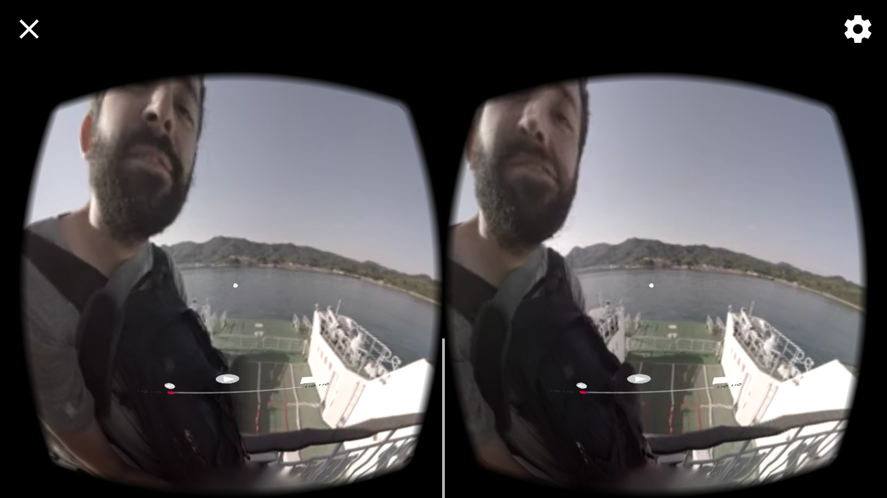
Technical Demo
Try out our tech for yourself!
Take a look around in the goggles, take a virtual trip to a boat in Japan
Pause, play, and move around the video using the controls/button
Future development:
Scenarios
Reward systems
Coping mechanisms
Surveys
Natural language processing
Notes:
Yesenia
With future iterations we will add new features, including reward/coping systems, surveys, and language processing, eventually making an inexpensive, easy to use, and feature rich VR application for therapy.

Slide 6
Market Research
Little market research on VR therapy
No overlapping patents
Competitors:
Existing small VR apps
Limbix
Psious
Virtually Better
Notes:
Now you’ve seen our technology, let’s talk about what else is out there.
Little general market research on VR therapy, but it is a currently small, yet growing field. We are uniquely positioned to grow with this sector. However, we know that millions of people are affected by relevant disorders, all of whom represent potential users.
No overlapping patents
A few with complicated bio feedback mechanisms or hardware that we have no interest in.
Competitors include small VR apps, which aren’t meant for therapy use and so probably won’t really compete
Limbix and Psious are both existing competitors, but that have expensive, complicated, devices for sale.
Limbix costs $2000, Psious doesn’t even list pricing, and seems to operate out of Spain. Virtually better’s cheapest system costs about $800.
We simplify all of this by just having goggles, a phone, and a subscription business model.

Slide 7
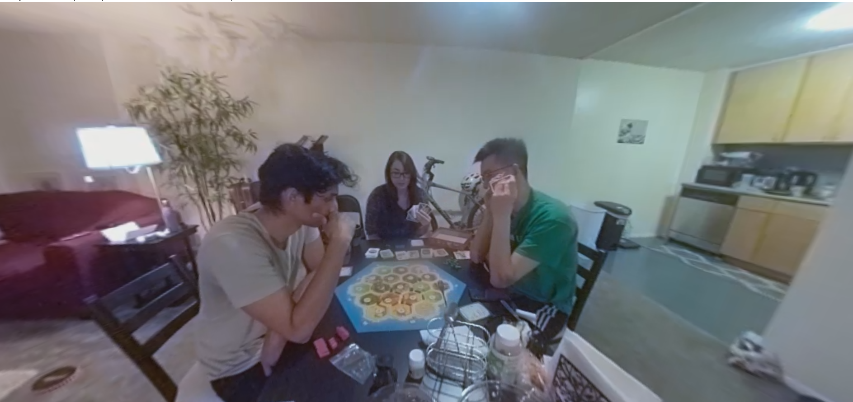
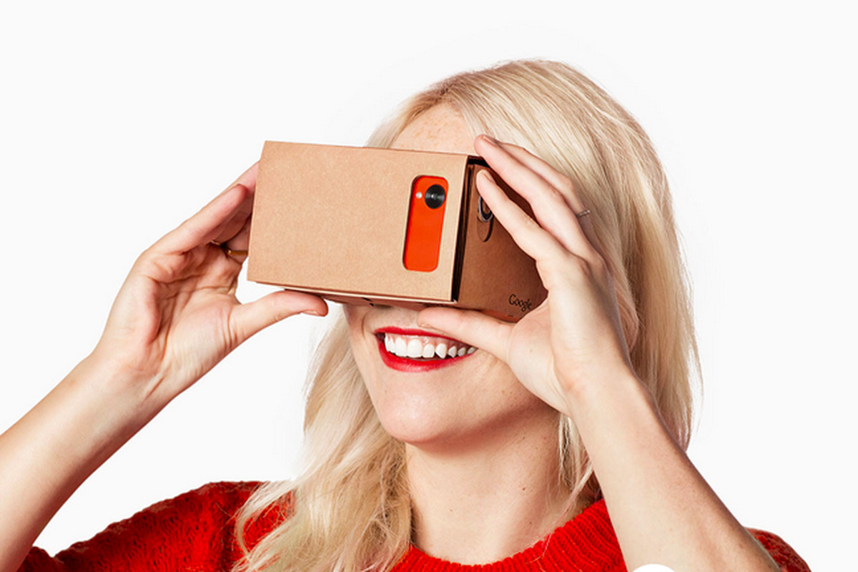
Business Plan
Partner with clinicians
Kennedy Krieger Institute
FDA Pre-submission
Subscription business model
Consistent income
Accessible and familiar
Fair to users
Estimated Revenue:
Patient estimate from Luke?
$500,000 to get started
Talent, tools, actors, and space
https://macintoshhowto.com/google/how-to-use-google-cardboard-vr-with-an-iphone.html
Notes:
Tools for development, like cameras, and development tools for Mac/iOS.
We will also need to hire actors and rent space to record some of the scenarios that have been requested.
Talk through what’s needed to take a VR Video.

Slide 8
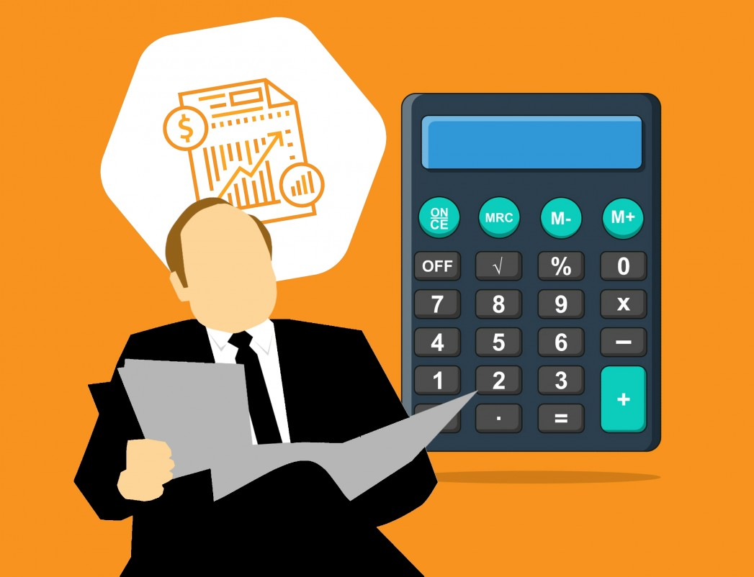
Expenses - First Year
Expense | Cost
Equipment | $2,000
Scenario Creation | $8,000
App Developer Salaries x2 | $200,000
Founder Salaries | $150,000
FDA and Clinician Consultants | $70,000
Offices and Maintenance | $20,000
Emergency Funding | $50,000
Total | $500,000
https://pxhere.com/en/photo/1449659

Slide 9
Thank you! Questions?
Sia
Special thanks to Dr. Luke Kalb, Dr. Amy Keefer, and Dr. Joe McGuire

Slide 10
Sources
Locke, Amy B, Nell Kirst, and Cameron G Shultz. 2015. “Diagnosis and Management of Generalized Anxiety Disorder and Panic Disorder in Adults.” American Family Physician 91 (9): 617–24. https://www.clinicalkey.com/#!/content/playContent/1-s2.0-S0002838X15301040.
Maples-Keller, Jessica L., Brian E. Bunnell, Sae Jin Kim, and Barbara O. Rothbaum. 2017. “The Use of Virtual Reality Technology in the Treatment of Anxiety and Other Psychiatric Disorders.” Harvard Review of Psychiatry 25 (3): 103–13. https://doi.org/10.1097/HRP.0000000000000138.
Opriş, David, Sebastian Pintea, Azucena García-Palacios, Cristina Botella, Ştefan Szamosközi, and Daniel David. 2012. “Virtual Reality Exposure Therapy in Anxiety Disorders: A Quantitative Meta-Analysis.” Depression and Anxiety 29 (2): 85–93. https://doi.org/10.1002/da.20910.
Park, Mi Jin, Dong Jun Kim, Unjoo Lee, Eun Jin Na, and Hong Jin Jeon. 2019. “A Literature Overview of Virtual Reality (VR) in Treatment of Psychiatric Disorders: Recent Advances and Limitations.” Frontiers in Psychiatry 10 (July): 1–9. https://doi.org/10.3389/fpsyt.2019.00505.
Valencia, Katherine, Cristian Rusu, Daniela Quiñones, and Erick Jamet. 2019. “The Impact of Technology on People with Autism Spectrum Disorder: A Systematic Literature Review.” Sensors (Basel, Switzerland) 19 (20): 1–22. https://doi.org/10.3390/s19204485.

