Slide 1
ON-SITE POLYMER CAST
DAVID SVETLIZKY
RAVIT YEHOSHUA
MOR FIEGENBAUM

Slide 2
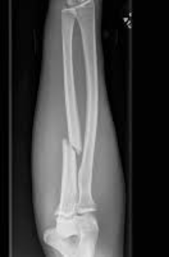
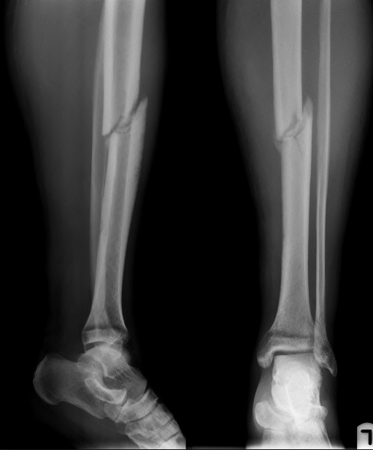
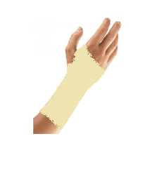
ON-SITE POLYMER CAST
The Problem:
The conventional plaster casting is heavy, itchy and no water prof
The solution:
Low cost, easy to use UV curable cast

Slide 3
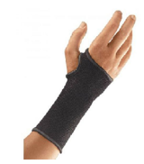
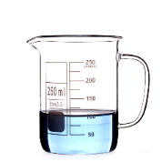
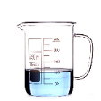
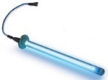
THE PRODUCT
Mixing the epoxy with UV initiator
for a viscous paste
Hardening the polymer
with UV lump
Elastic hand cover
on the injured area
Spreading the polymer
on the Elastic cover.
Removing the
elastic hand cover
Simple “low tech” solution for 3D printed cast
No need in complex scanning and modeling devices and technicians
Easy to use kit
The material is not in contact with the skin

Slide 4
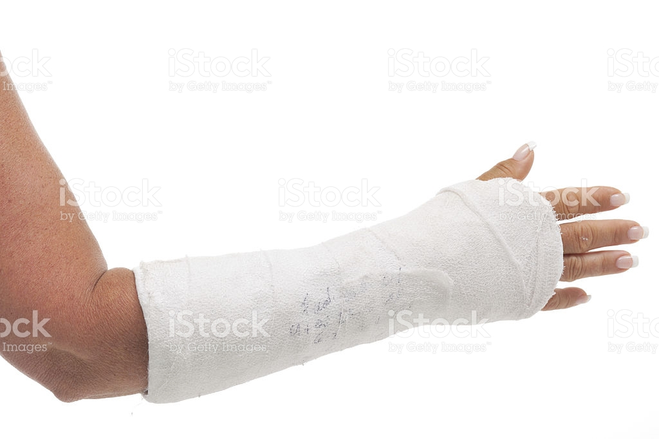
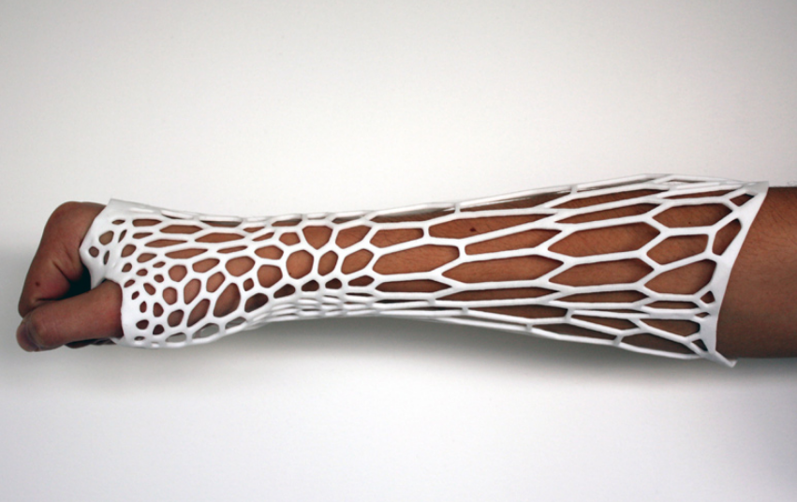
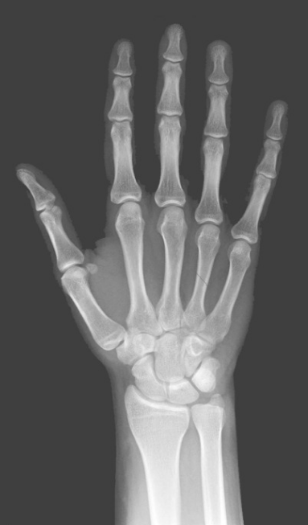
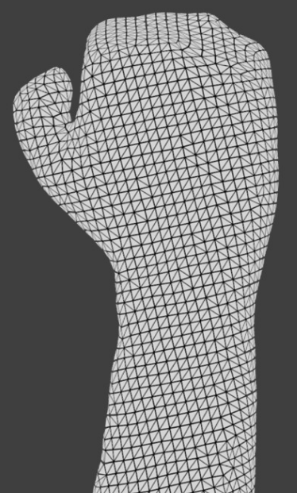
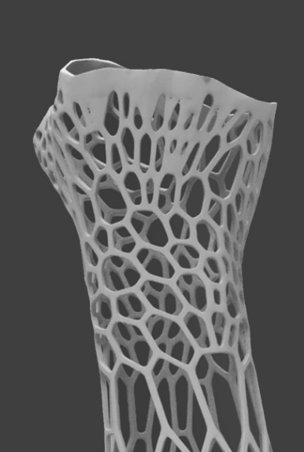
MARKET SURVEY
Orthopedic cast
3D Cast
Pros
Cons
Pros
Cons
X-RAY
Low cost
Heavy
Anatomically accurate
high cost
3D SCAN
High moldability
Not water resistance
Hygienic and Waterproof
Requires Engineer
Low tech
Itchy
Light and Ventilated
Long process
3D PRINT
Recyclable

Slide 5
IT’S ALL ABOUT THE MONEY
Orthopedic cast
3D Cast
UV cast
50$
500$
30-50$

Slide 6
IT’S ALL ABOUT THE MONEY
6.3 million fractures occur annually in USA
A fracture accrues every 5 seconds
2.4% are likely to experience a fracture per year
Demand for casts and splints is visibly high in countries such as India, Korea, and China.
The overall value of the global casting market is US$1.8 billion in 2015.
The market is poised to reach US$3.1 billion at 2024.

Slide 7
FUTURE WORK
First step investment
1.5 million dollars
Our goals:
Develop an optimization of curing process
Develop UV initiator for fast hardening
Optimization of the assembly process
Design optimization (style, practicality)

