Slide 1
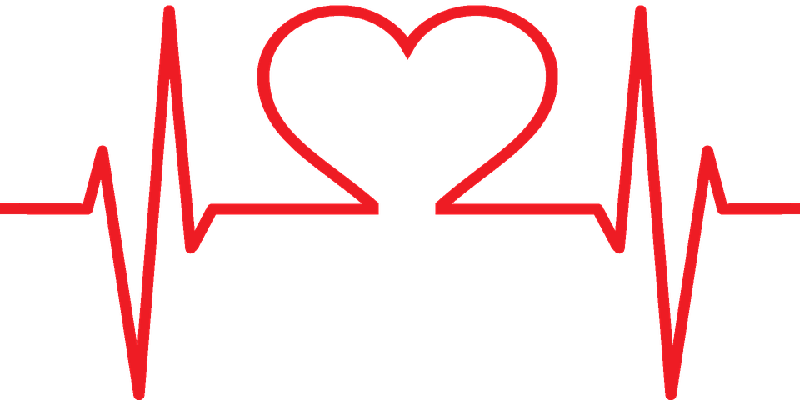
LifeSense
Presenting:
Dikla Kesner, Orr Golan & Guy Kidron

Slide 2
Sudden Cardiac Death The Danger
In the US alone, every year, over 630,000 adults die of heart disease.
More than half of these deaths occur suddenly and without warning – about one death every minute.
When the person afflicted suffers heart failure during waking hours – he can receive assistance readily and increase the chances of survival.
During the night and sleep – a person suffering heart failure will not present any symptoms and will not receive treatment, making death a virtual certainty.

Slide 3
Sudden Cardiac Death The Need and the Market
Monitoring devices exist in the market but limited access to the general population
The current market size for monitor devices is estimated at 410M$, and is expected to grow to 680M$ within the next 7 years.
The entire cardiac monitoring market is estimated at 20B$.

Slide 4
LifeSensor The LifeSense Solution
Introducing the LifeSensor :
Contact-free and hands-free use
One time installation beneath the bed mattress
Alarm sound notification, alerting medical care in case of emergency
Reliable and robust with internal backups to guarantee continuous operation
Capable of capturing a vast wealth of data related to heart function for analysis by experts for tracking of cardiac disease progression

Slide 5
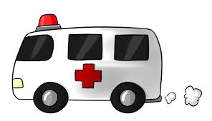
LifeSensor The Technology
The LifeSensor utilizes an amplified microphone array, implementing cheap and common hardware.
Noise cancellation algorithm enables the LifeSensor to accurately take measurements of the heart remotely – eliminating the inconvenience of attaching the device to the user’s body.
Using Wi-Fi/GSM networks allow the LifeSensor to automatically alert the medical care personnel – minimizing the response time and increasing chances of survival.
Application of analysis algorithms allows the device to isolate and measure more than one heart beat – allowing for use at home with any standard bed even if more than one person is in measurement range.

Slide 6
LifeSensor Business Plan
Initial marketing for home-use data gathering.
Marketing for commercial venues with large numbers of beds (retirement homes, hotels, etc.) This strategy also appeals to aspects of insurance and increasing the business's client safety.
Marketing to healthcare organizations: clinics, hospitals, etc. While those institutions normally have monitoring equipment, the LifeSensor will be significantly cheaper and easier to maintain.

Slide 7
LifeSensor Medical Regulation
The LifeSensor is not intended to be used as a medical monitor therefore it is not defined as medical equipment and as such is not limited by current regulations in most countries around the world.
In the future, it is possible to seek FDA approval (or equivalent) as a Class I device (sec. 870.2390) which is exempt from premarket notification and requires mainly data proving the system efficiency.

Slide 8
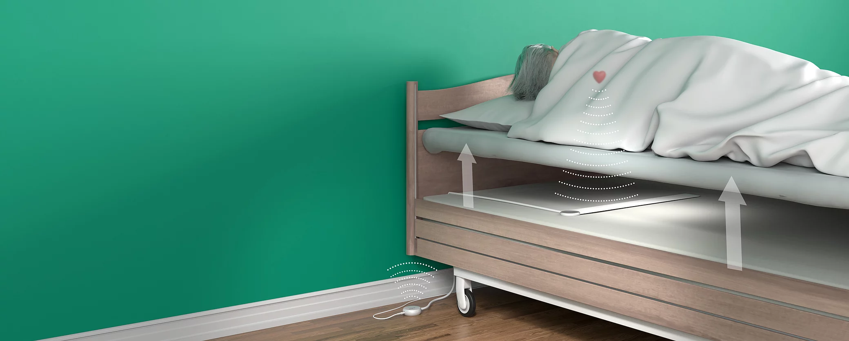
LifeSensor Installation

Slide 9
LifeSense Patents and Legal Concerns
List of similar patents :
Mattress for resting or sleeping of a person US20180049701A1
Sleep monitor USD807512S1
Sensor system for monitoring the condition of a person and method for its manufacture EP1267710B1
Method and Apparatus for Measuring and Monitoring Vital Functions or Presence US20070276202A1

Slide 10
LifeSense First Budget
Cost k$ | Stage
500 | Development work
25 | Patent
200 | Production
25 | First Regulation
250 | Prototype
250 | Second Regulation
1.25 M | Total

Slide 11
LifeSense
Questions ?

