Slide 1
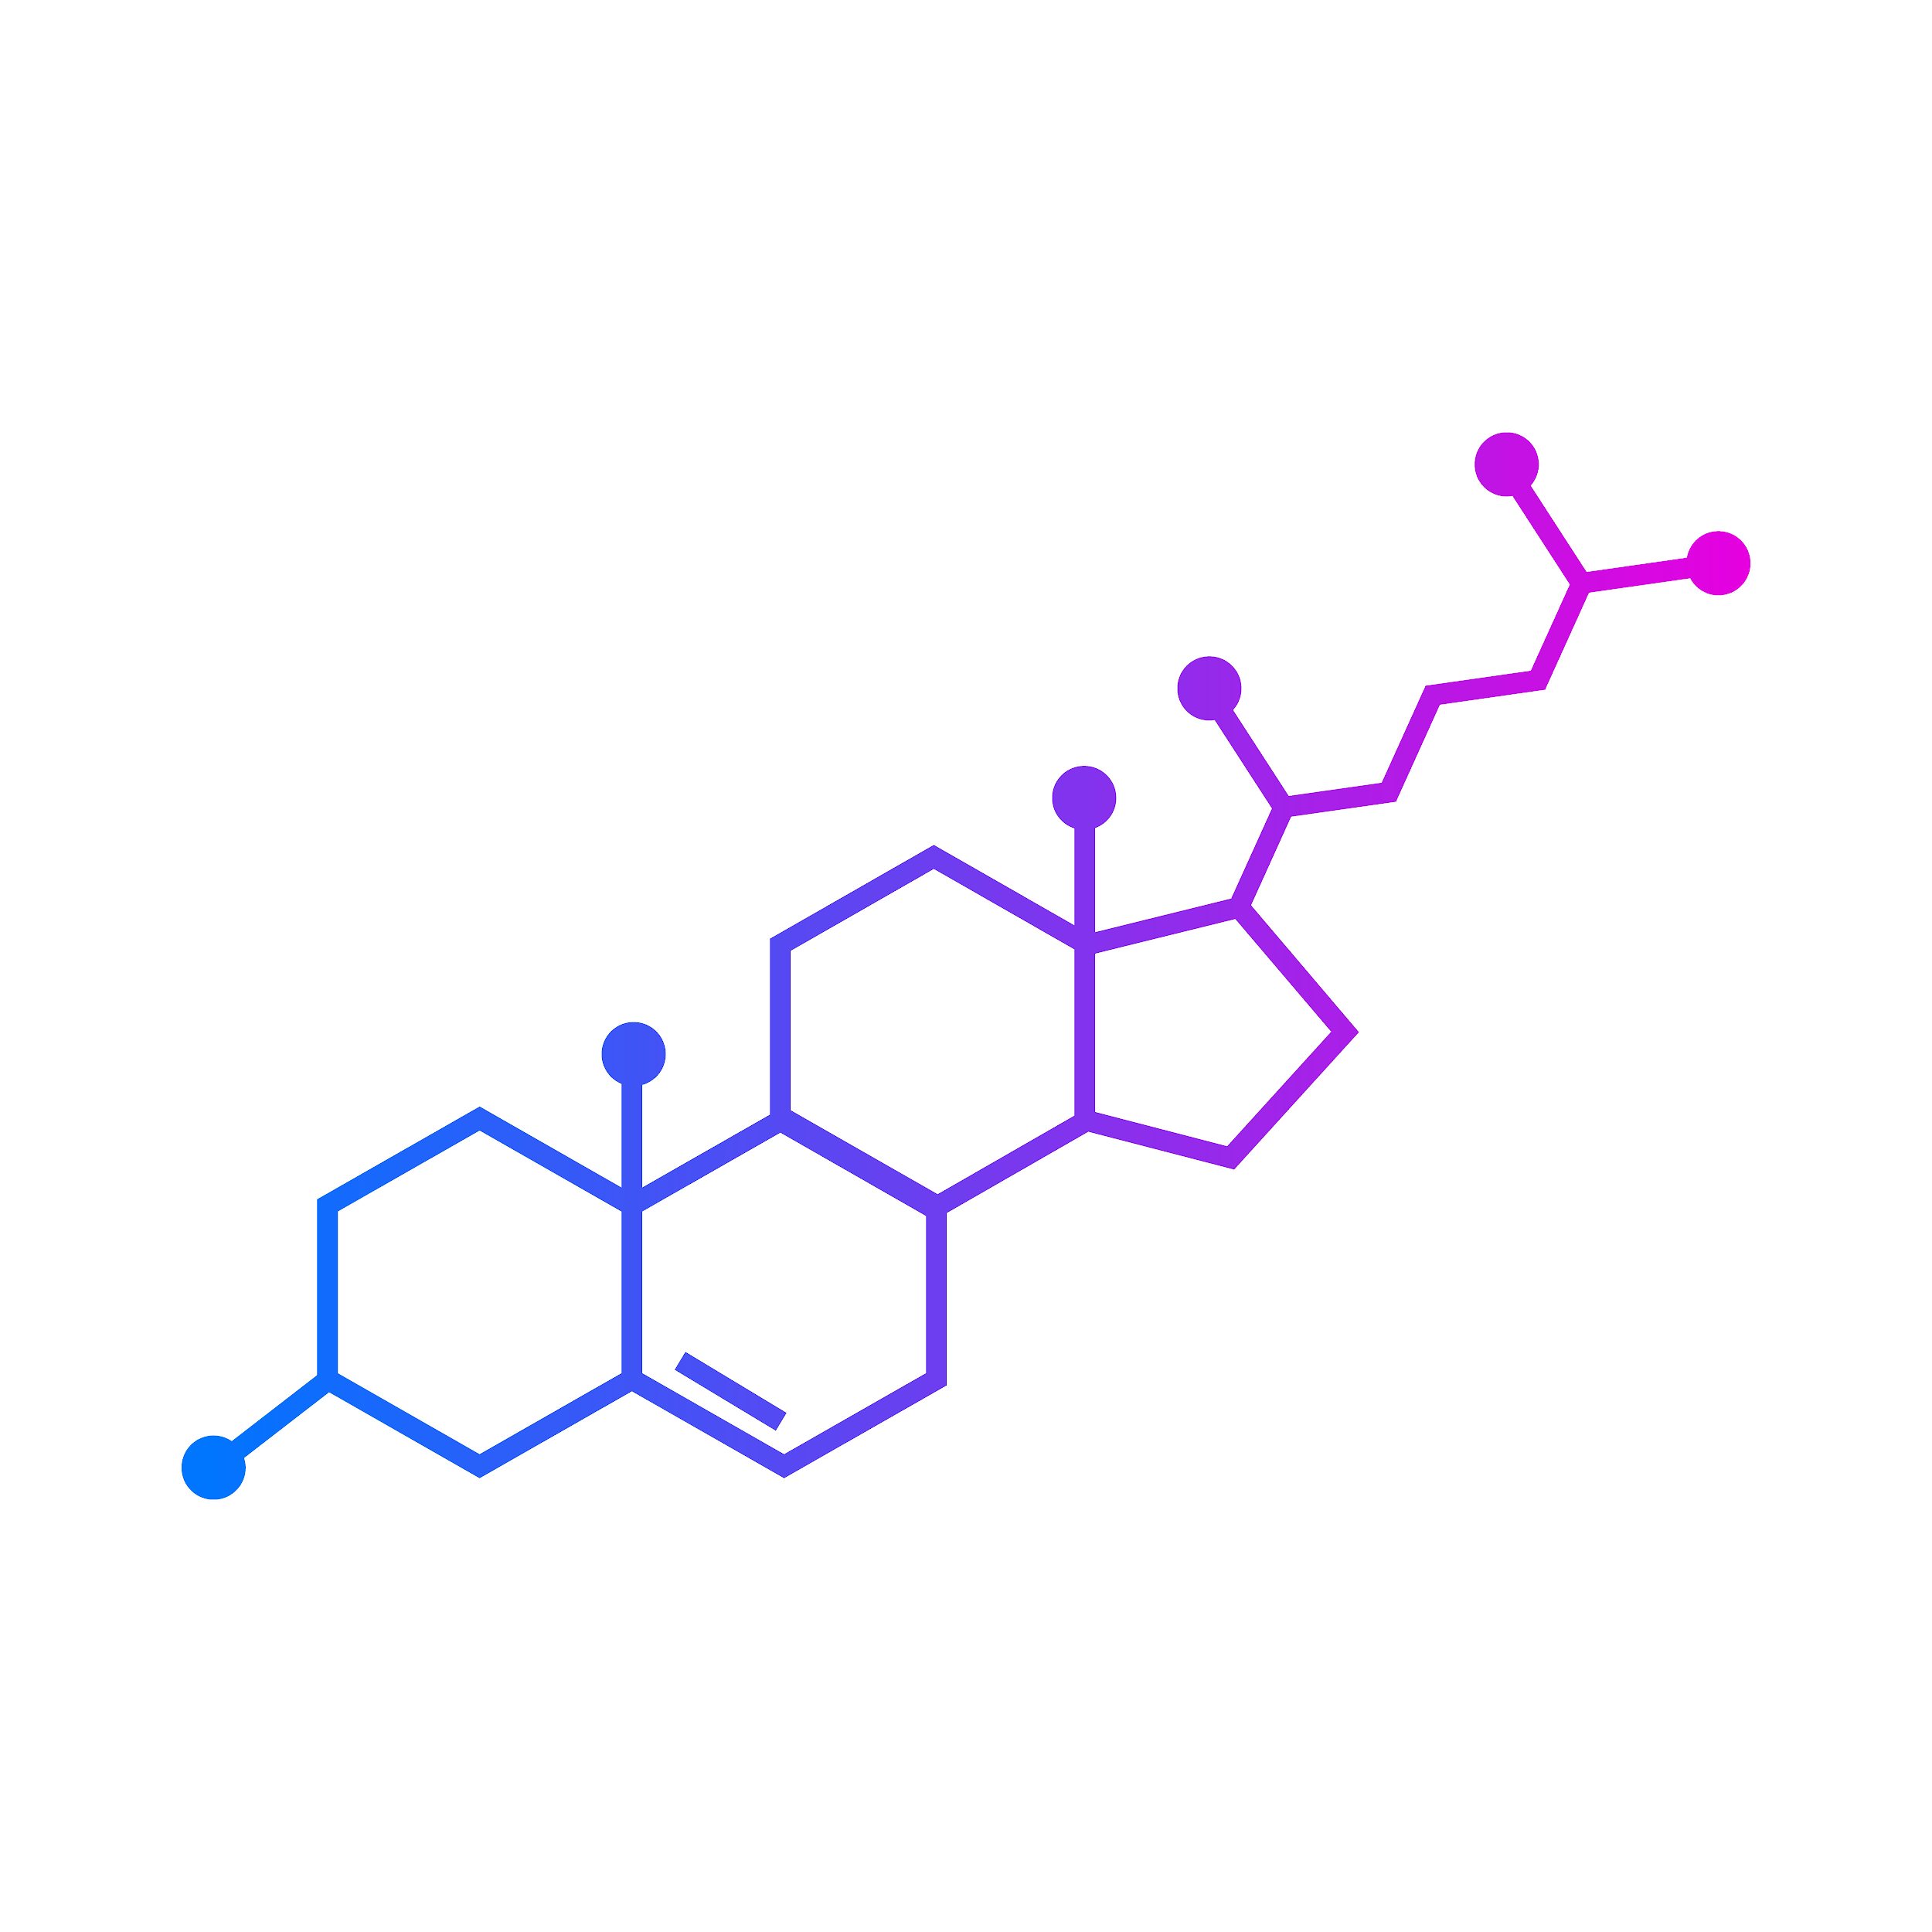
LesteroLight
Alia Nasrallah, Kushal Sreenuprasad, Rayan Albokhari

Slide 2
Biography
Alia:
B.Sc., ECE, George Washington University, 2012
M.Sc., ECE, Johns Hopkins University, 2016
Ph.D., ECE, Johns Hopkins University, 2019-present
Kushal:
B.E., BME, Ramaiah Institute of Technology, India, 2019
M.Sc., BME, Johns Hopkins University, 2019-present
Rayan:
B.Sc., BME, Wentworth Institute of Technology, 2017
M.Sc., BME, Johns Hopkins University, 2019-present

Slide 3
Have you or someone you know been diagnosed with high Cholesterol?

Slide 4
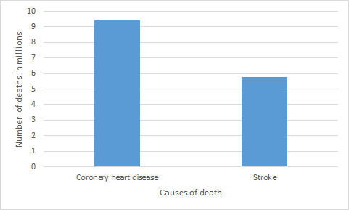
Leading Causes of Death Worldwide in 2016
(in millions) ¹
Notes:
Coronary heart disease (CAD) continues to be a leading cause of death worldwide and elevated cholesterol and triglycerides are among the important risk factors for this disease.
Patients are more aware of the fact that diet and exercise can alter blood levels of cholesterol as well as drug therapy.
Atherosclerosis is the major cause of CAD. It is characterized by a focal deposit of cholesterol and lipids, primarily within the intimal wall of the artery.

Slide 5
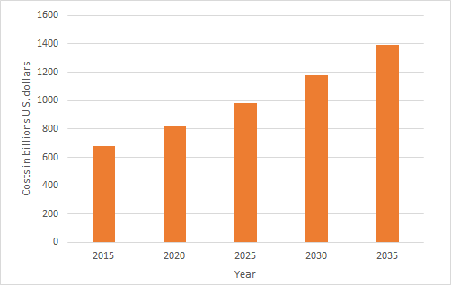
Projected Total Costs of CVDs in U.S. from 2015 to 2035
(Billions USD) ²
Total costs will add up to over 1 trillion USD
Notes:
This statistic shows the projected total cost of cardiovascular disease in the U.S. from 2015 to 2035, by disease type, in billion U.S. dollars. It was estimated that by the year 2035, high blood pressure would cost the United States around 220 billion dollars, while total costs from all cardiovascular diseases would add up to about 1.1 trillion dollars.

Slide 6
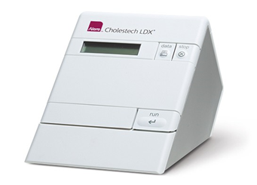
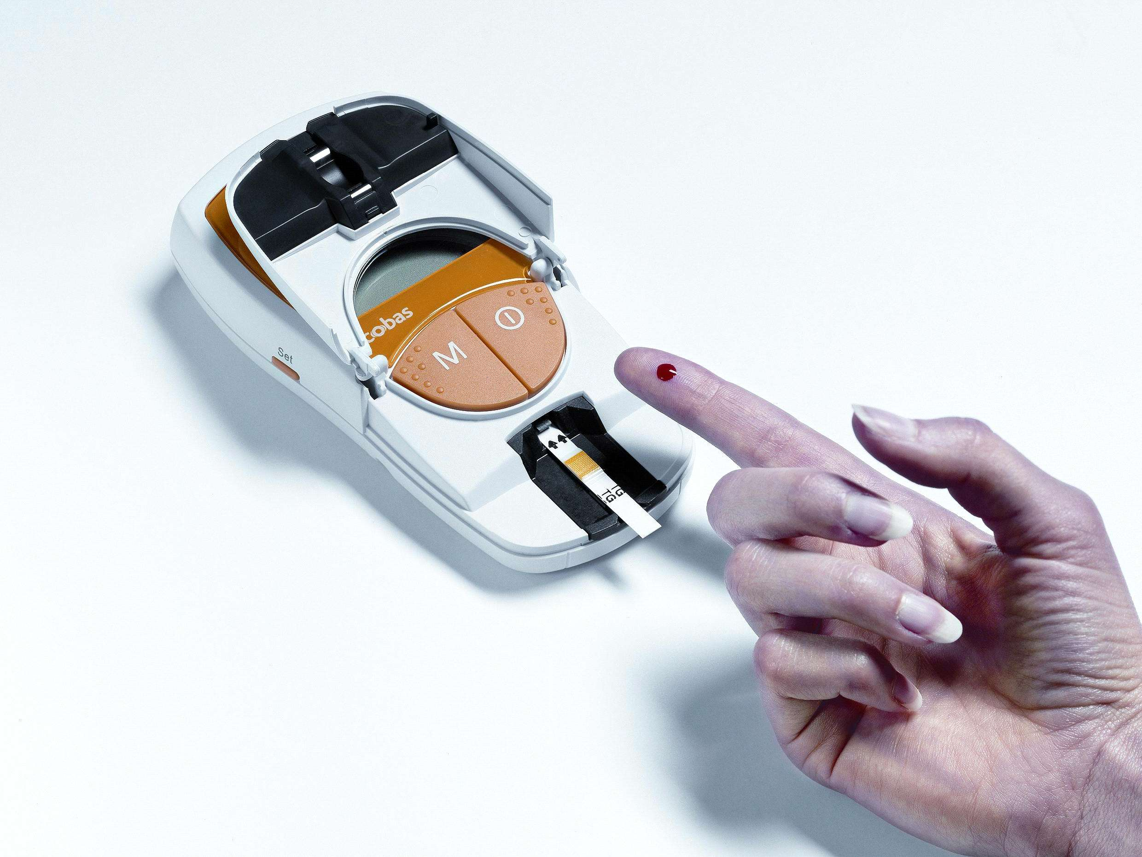
Invasive and Minimally Invasive Cholesterol Test Devices
Alere LDX Analyzer ³
Accutrend Plus ⁴
Notes:
Elevated cholesterol levels is an important risk factor for Cardiovascular diseases (CVDs). Therefore, there is a need to reliably monitor cholesterol levels on a regular basis. Typically, Point-of-Care (POC) cholesterol tests are conducted in an invasive and minimally invasive manner, requiring the use of needles to take the test. The problem is that patients are reluctant to prick their fingers for a test.

Slide 7
Market Size: 2018-2023
Cholesterol Testing ⁵
$2.5-$3.5 billion
$38 billion by 2023
Needle-Free Devices ⁶
$3.0-$4.6 billion
Wearable Devices ⁷
$8.9-$29.9 billion
$14.4 billion in 2018

Slide 8
LesteroLight
Non-Invasive Cholesterol Monitoring Wearable Device

Slide 9
Our Device
Targeted Population
Preventative tool
User-friendly
Cost effective
Portable and with a sleek ergonomic design
8
CVD patients
Individual with high risk of CVDs
Fitness enthusiasts
Clinical use
9
Notes:
CVDs patients.
Individual with high risk of CVDs.
Fitness enthusiasts
Clinical use

Slide 10
Device Design

Slide 11
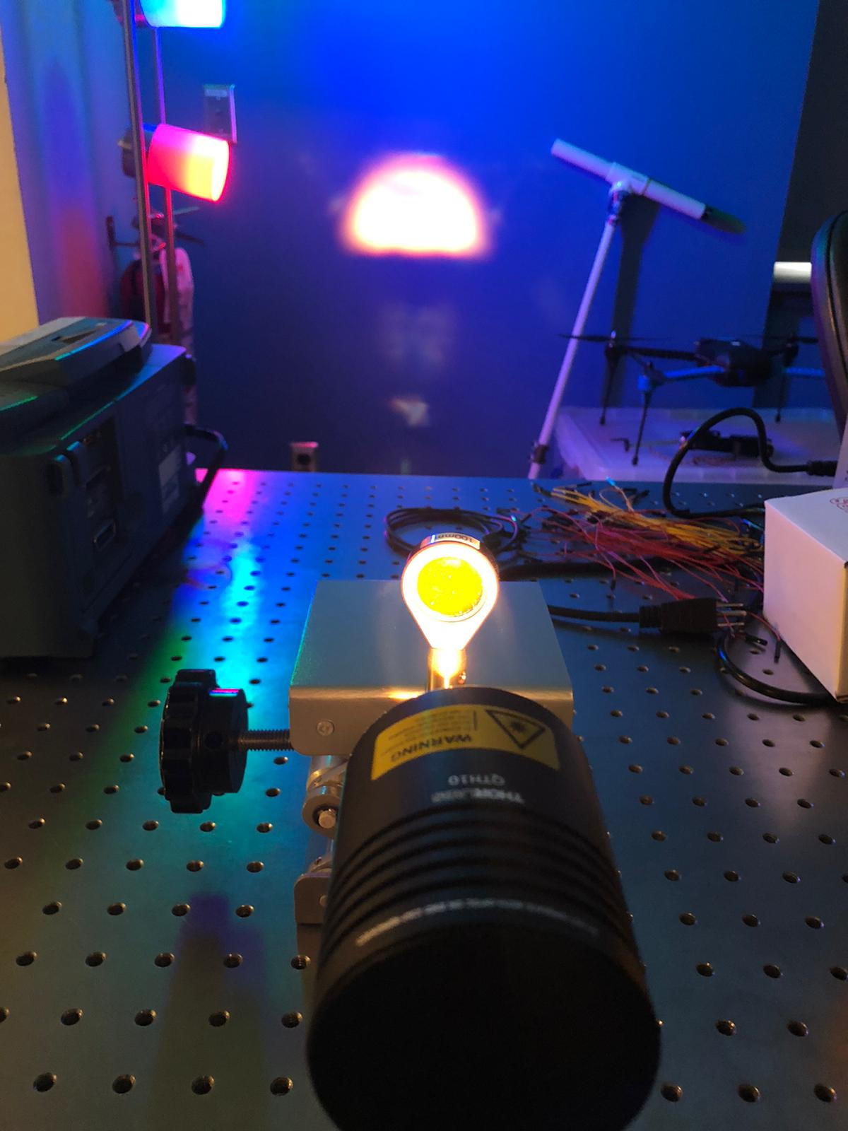
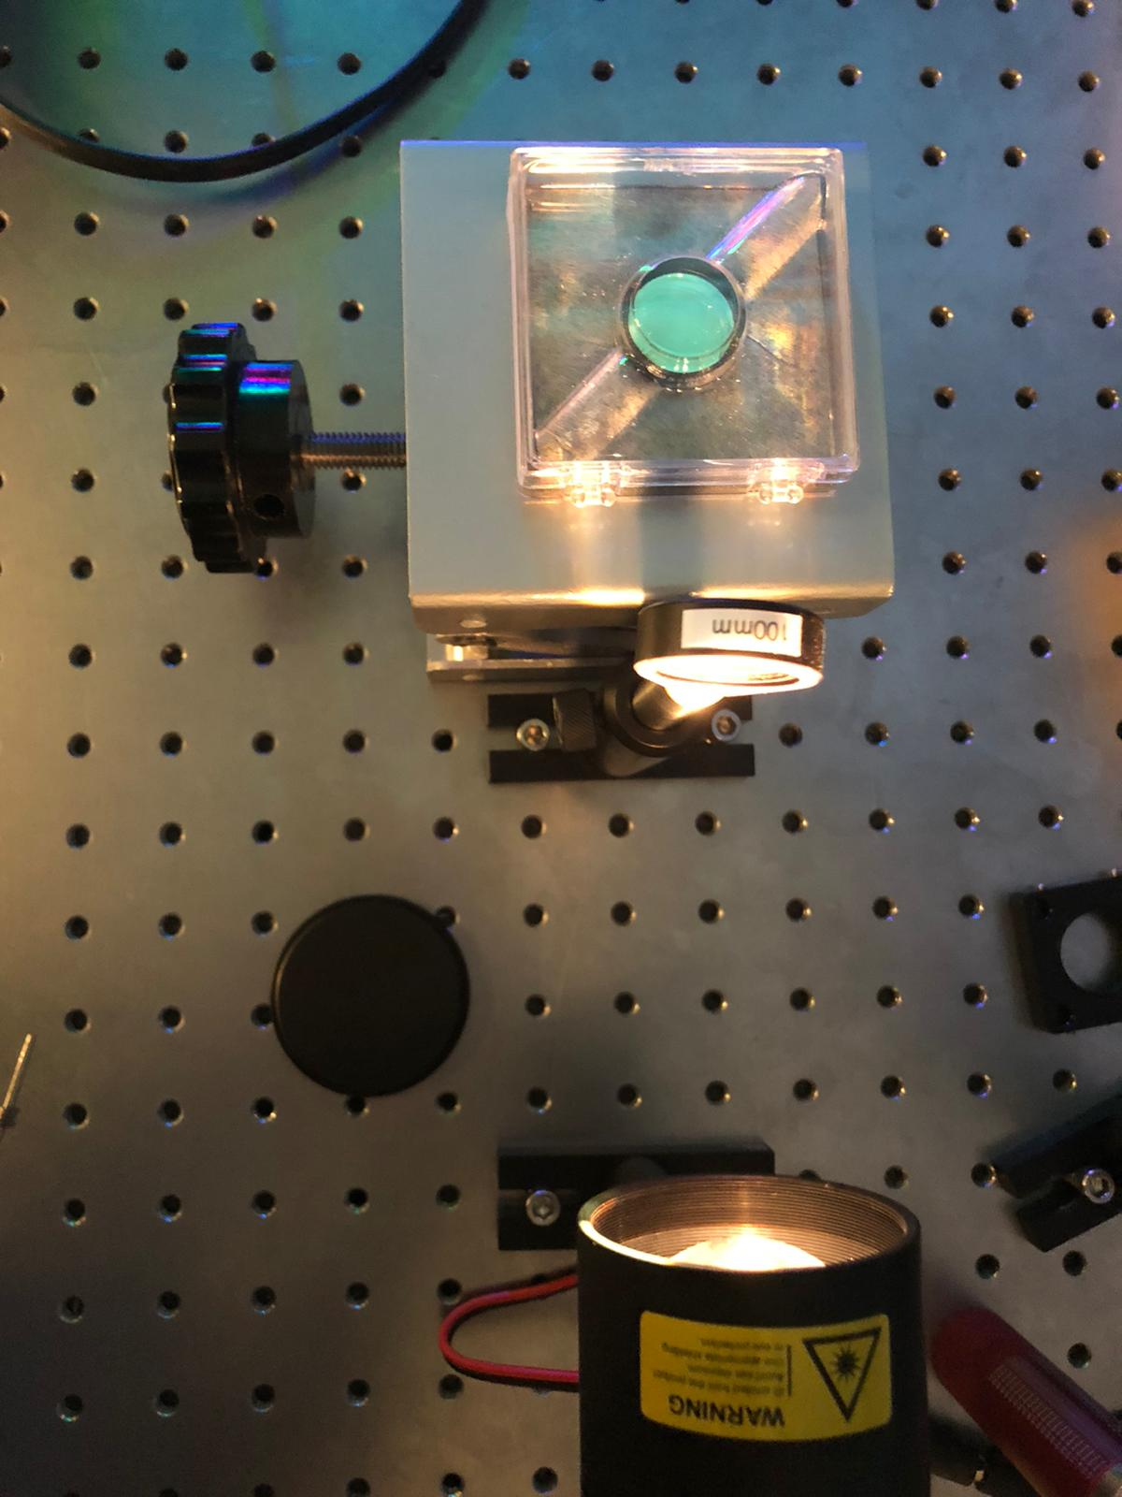
Current Setup and Progress

Slide 12
One Year Budget: $500,000
Item | Cost
Contractors | $75,000
Optic Engineers | $125,000
Software Engineers | $125,000
Equipments | $150,000
Office Space | $25,000

Slide 13
1st Round Fund Target: $1,000,000

Slide 14
References
¹https://www.statista.com/study/41355/cardiovascular-disease-in-the-us/
²https://www.statista.com/statistics/671590/cardiovascular-disease-cost-forecast-us-by-disease-type
³https://www.alere.com/en/home/product-details/cholestech-ldx-system.html
⁴ https://diagnostics.roche.com/us/en/products/systems/accutrend_plus-system.html
⁵https://www.statista.com/statistics/726084/us-point-of-care-diagnostics-and-testing-market-size/
⁶ https://www.bccresearch.com/market-research/healthcare/needle-free-devices.html
⁷https://www-bccresearch-com.proxy1.library.jhu.edu/market-research/healthcare/wearable-medical-devices.html
⁸https://healthplanethub.com/wp-content/uploads/2019/10/20191010_145845.jpg
⁹https://i.ndtvimg.com/i/2017-07/heart_650x400_81501491246.jpg

