Slide 1
AgCENSE

Slide 3
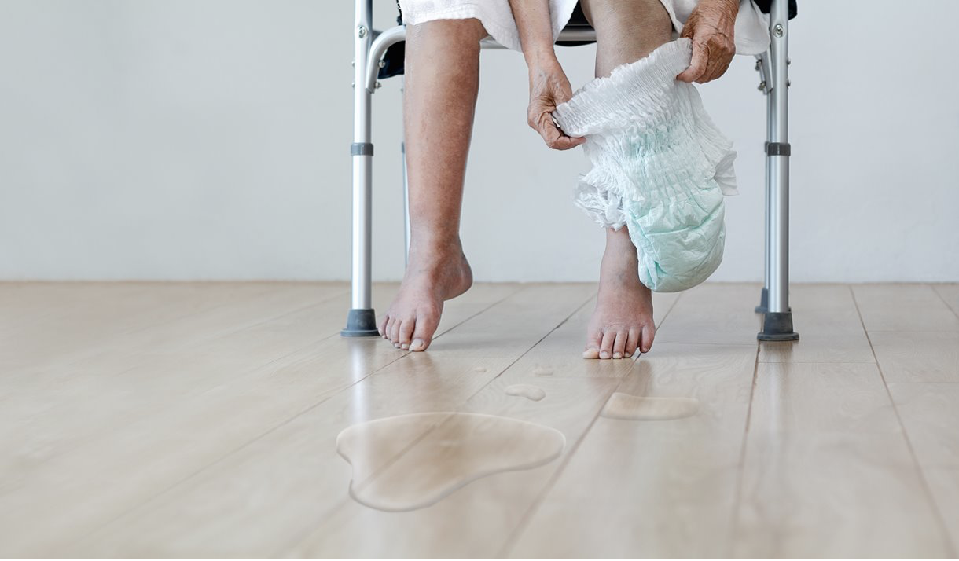
BACKGROUND:
INCONTINENCE: loss of bladder & bowel control
Elderly population > 10 million need long-term care services
15,600 nursing homes in the US
Nursing homes (US) -> 1.5 million people (aged 65 or higher)
All images are from public domain

Slide 4
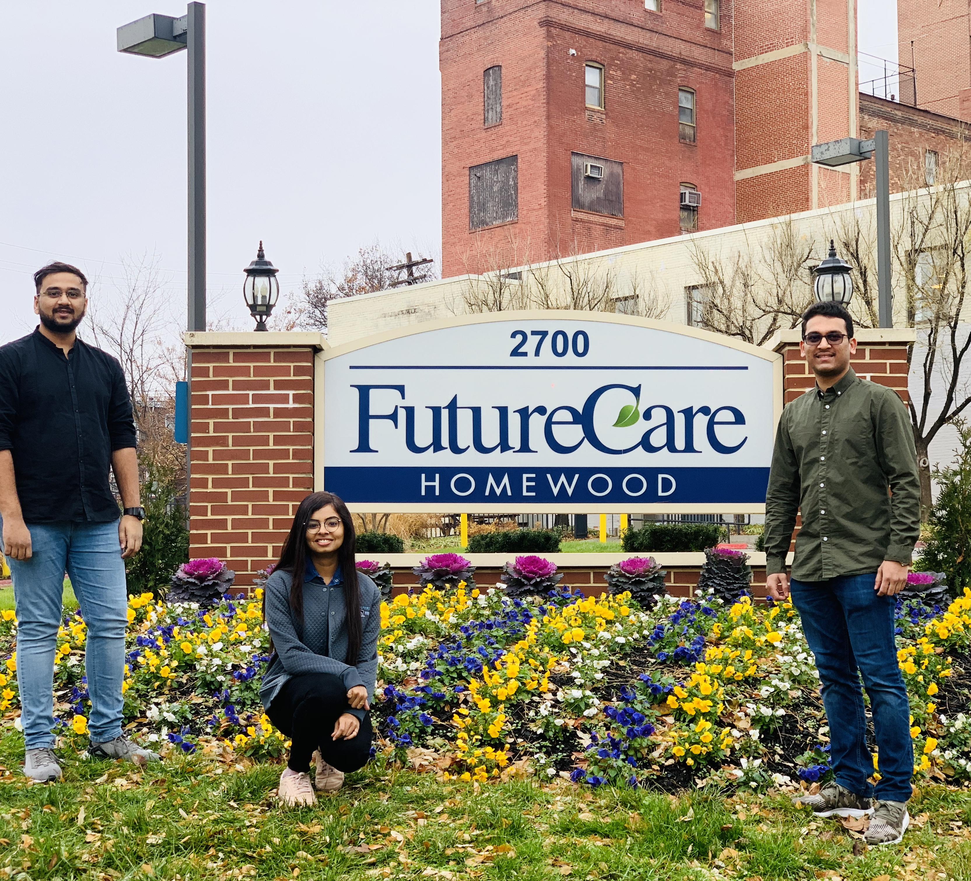
PROBLEM STATEMENT:
More than 50 % patients incontinence
Low NPR
Untimely cleaning
Patients soaked in urine/feces LONG HOURS UTI, skin breakdown
Motivation: resolving the issue of untimely cleaning

Slide 5
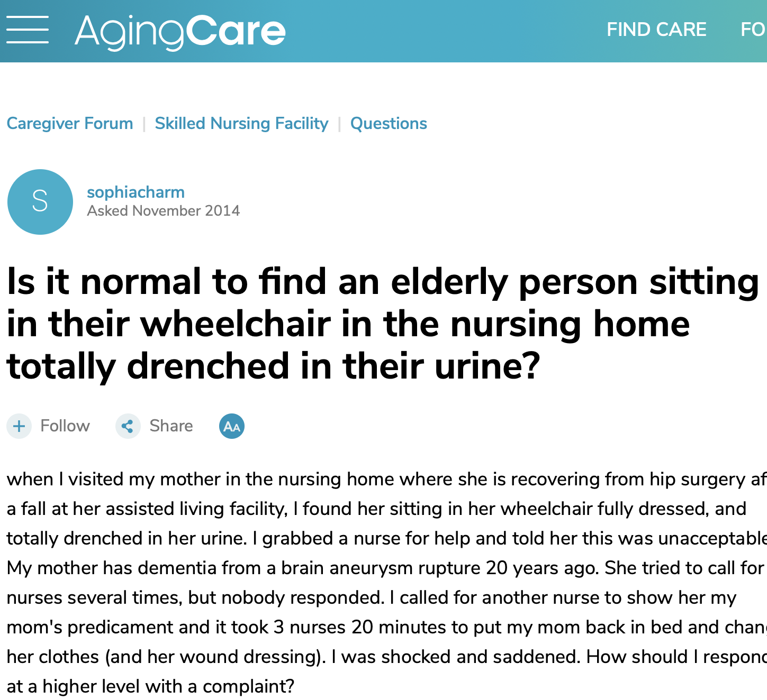
All images are from public domain

Slide 6
PROPOSED SOLUTION:
Regulation body
Head Nurse
Telemetry
.
.
.
Router
Nursing Station
.
.
.
.
. . . . . . . . . . . . . . . .
Sensor
. . . . . . . . . . . . . . . .
All images are from public domain

Slide 7
REVENUE MODEL:
Fixed Priced Model : AgCENSE
Razor/Razor blade model for consumables : Disposable Sensors
Renewal fee : Licensed software
Volume based discounts
All images are from public domain

Slide 8
What we are asking for (Yearly):
R&D engineer
170,000
Software engineer
85,000
Network engineer
85,000
Office Space
30,000
Regulation
200,000
EQUIPMENTS
370,000
Miscellaneous
100,000
All images are from public domain

Slide 9
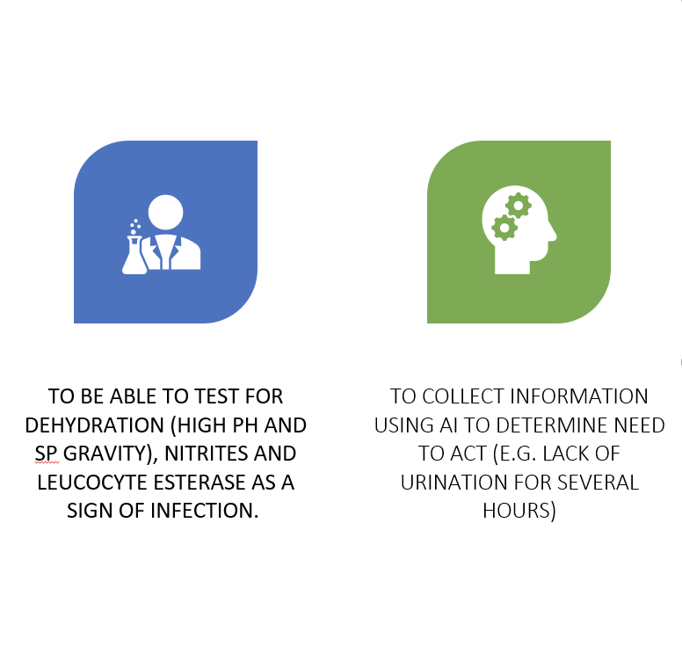
FUTURE GENERATIONS
All images are from public domain

Slide 11
THANK YOU
OLD AGE IS NOT A DISEASE-IT IS STRENGTH & SURVIVORSHIP, TRIUMPH OVER ALL KINDS OF VICISSITUDES & DISSAPOINTMENTS, TRIALS & ILLNESS.
-Maggie Kuhn
All images are from public domain

Slide 12
REFERENCES:
Source U.S. Census. http://www.sandiegouniontribune.com/news/2016/may/12/aging-population-2050/ ​
https://www.mn-nursinghomeabuse.com/fecal-urine-odors-in-nursing-home/
https://nursinghomesabuseadvocate.com/blog/grace-living-center-brookwood-resident-sits-daily-in-urine-soaked-clothes-and-sheets/
https://www.agingcare.com/questions/elderly-person-in-wheelchair-in-nursing-home-drenched-urine-174384.htm

