Slide 1
INCEDO
An insole which monitors every move and provides real time step correction through active bio-feedback

Slide 2
Pain Points
Walking rehabilitation treatments are short and limited, home practice is crucial for an efficient treatment
Patients who suffer neurological disorders need to maintain a constant routine of physical therapy
Current solutions for fall detection are inadequate or conspicuous

Slide 3
Features
Concealed fall detection and alert system
Real-time bio-feedback gait correction
Easy-to-use app controlled features
Every step is a session in progress
Ongoing data acquisition and AI analyses

Slide 4
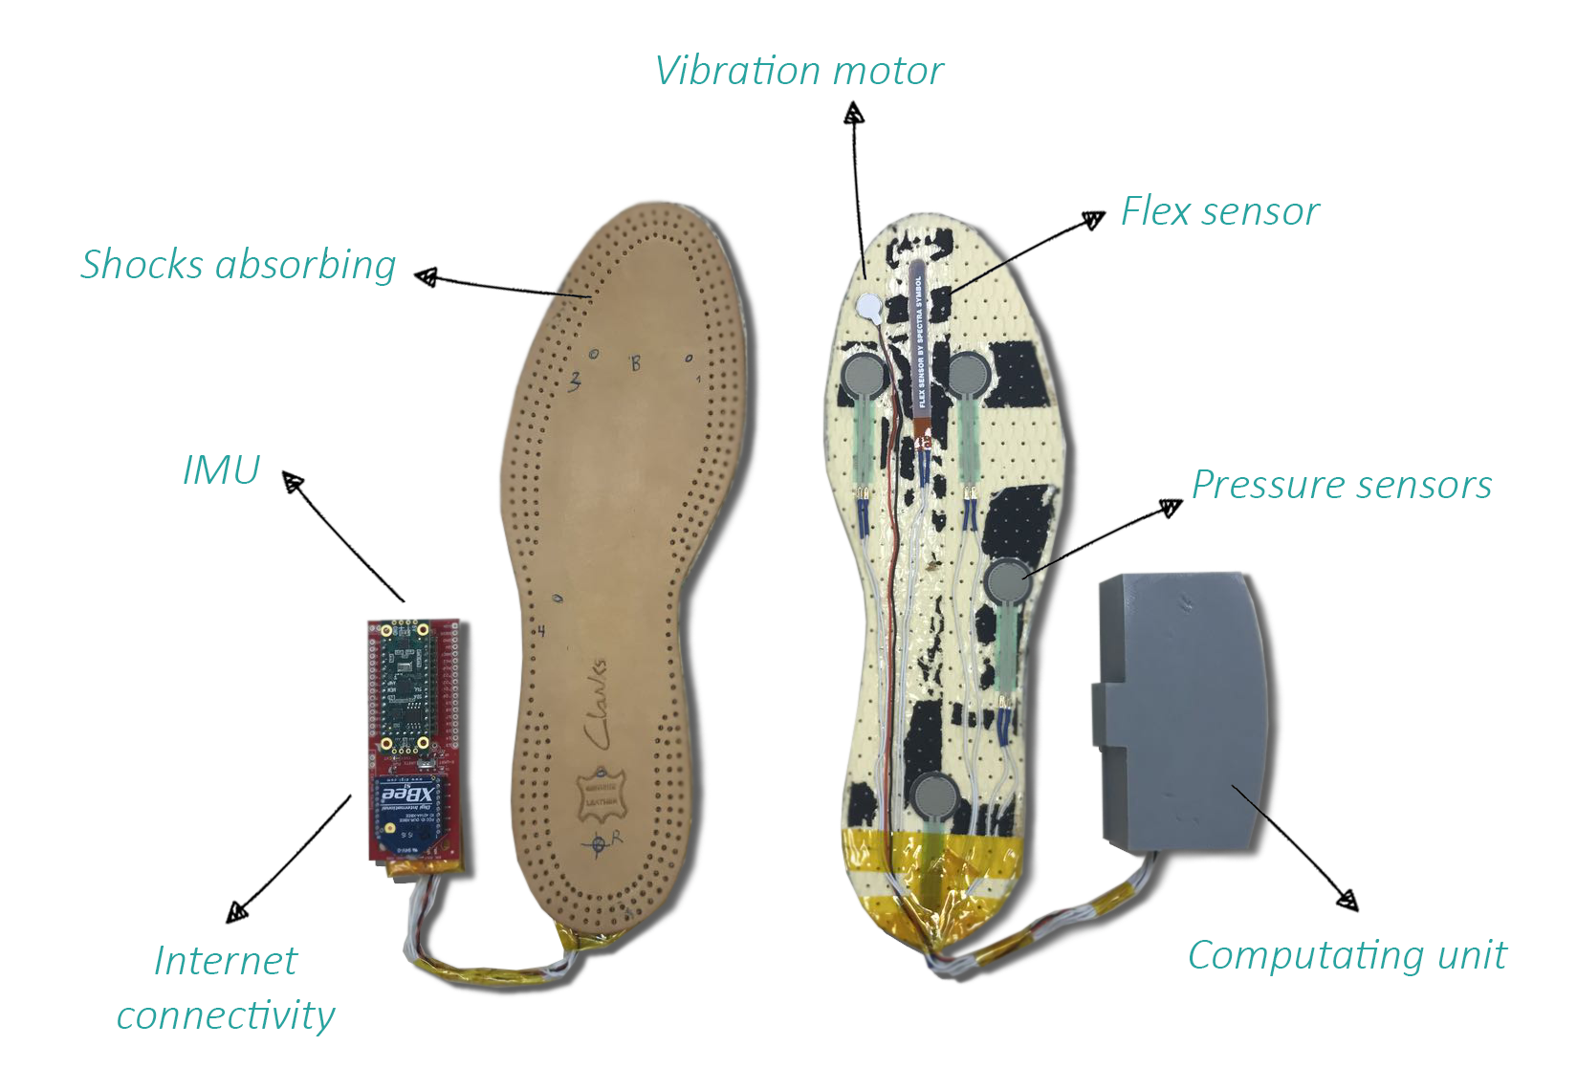

Slide 5
Regulation?
Go-To-Market
$5.6B
$17.6B
$73.2B
$50B

Slide 6
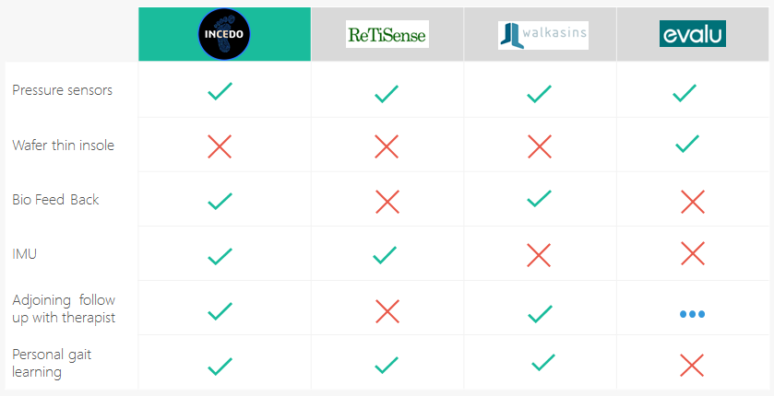
Landscape

Slide 7
Patents?
KR101803393 (B1) ― 2017-11-30
WO2018032365 (A1) ― 2018-02-22
CN107014377 (A) ― 2017-08-04
KR20170053222 (A) ― 2017-05-16

Slide 8
Roadmap
10/2018
04/2019
07/2019
Setting up a Company
MVP
Launch
07/2018
01/2019
05/2019
Introduction
Partnerships
Beta

Slide 9
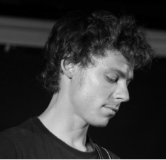
Team
Sol Fine CEO
Roei Zigelman
COO
Ben Torteman CTO
Or Shaviv
CSO
Frondeo
Co-Founder
solfine2@gmail.com
Applied M.
App. Engineer
roeizig@gmail.com
BioPuremax
R&D
bentorteman@gmail.com
Smart Medical Systems
R&D
shavivor@gmail.com

Slide 10
Use_{of}Funds
$200K
$700K
$400K
$1.7M
$250K
$150K

Slide 11
Thank You
Questions?

