Slide 1
Design of Biomedical
Instruments and Systems
Implantable Drug Delivery Device
Wenhao Yao
Yinghao Li
Junjun Chen

Slide 2
BACKGROUND
SOLUTION
OPPORTUNITY
MILESTONES

Slide 3
Global Problem
Non-adherence of patient medication
People Suffered
Decreases treatment effectiveness
Worsens disease
Causes death
System Impaired
290 billion dollars added in US alone
BACKGROUND
SOLUTION
OPPORTUNITY
FINANCIALS

Slide 4
BACKGROUND
SOLUTION
OPPORTUNITY
MILESTONES

Slide 5
IDDD: implantable drug delivery platform
Groundbreaking integration of ICP and IMD
The End: medication non-adherence
Convenience: controlled wirelessly
Precision: delivers exact amount
Longevity: lasts for years
BACKGROUND
SOLUTION
OPPORTUNITY
MILESTONES

Slide 6
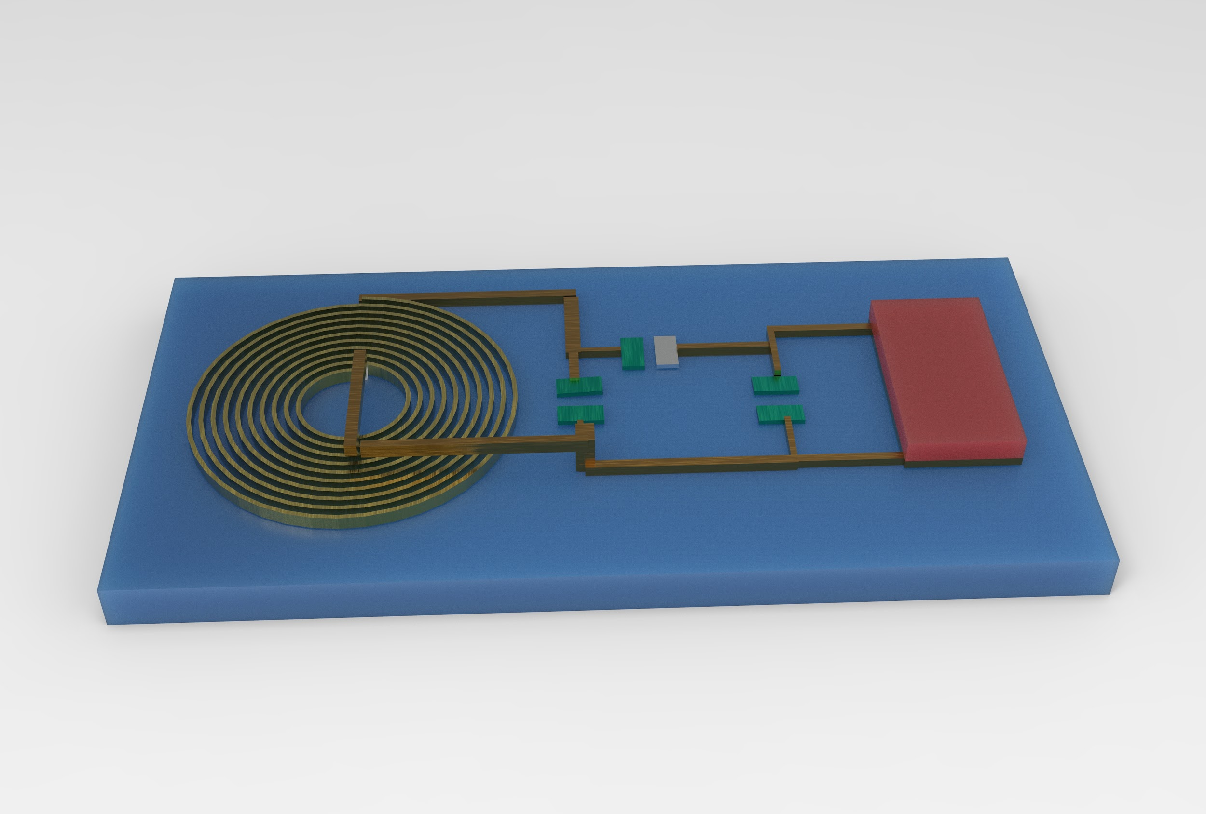
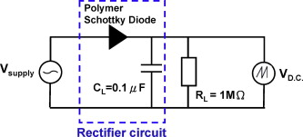
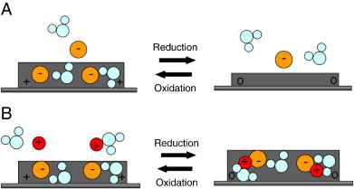
Implantable Drug Delivery Device
BACKGROUND
SOLUTION
OPPORTUNITY
MILESTONES
Notes:
Here I’ll show you some fancy technologies in this device. This is the structure of a device with a flexible substrate ,a metal coil ,a MEMS based AC-DC module and a drug loaded Conducting polymer.

Slide 7
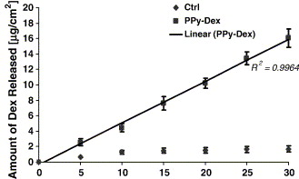
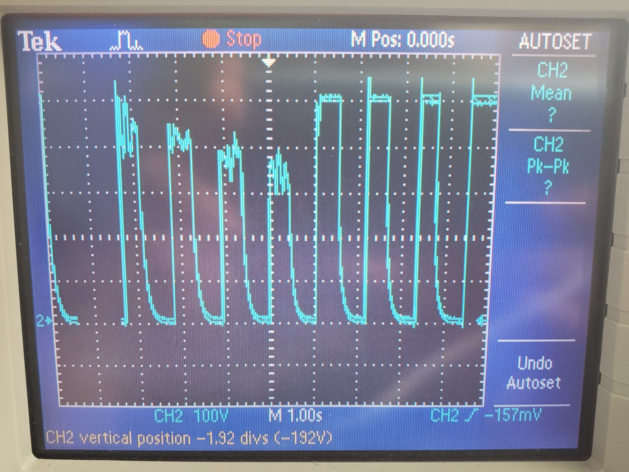
First Prototype
BACKGROUND
SOLUTION
OPPORTUNITY
MILESTONES
Patients
Self-manage their disease or condition
Doctors
Automate simple tasks for healthcare providers
Notes:
Here we made a prototype with a MCU a tx coil and a rx coil.You can see the energy passed to the r coil under the control of MCU.MCU + tx coil for a simulation of phone . RX coil for simulation of coil and AC_DC circuit of device.

Slide 8
BACKGROUND
SOLUTION
OPPORTUNITY
MILESTONES

Slide 9
Variety of Applications
Women’s health
Oncology
Pain management
Infectious disease
Central nervous system disorders
BACKGROUND
SOLUTION
OPPORTUNITY
MILESTONES

Slide 10
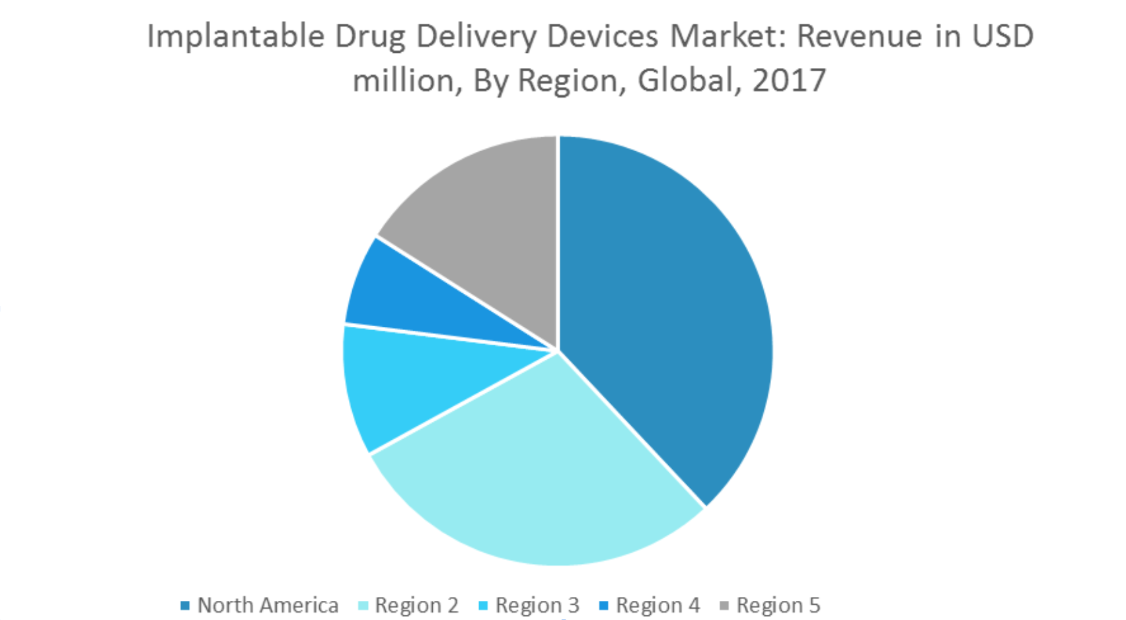
Market
$17 Billion Market
8.5% Annual Growth Rate
$34 Billion Expected by 2024
BACKGROUND
SOLUTION
OPPORTUNITY
MILESTONES
Competition
Boston Scientific Corporation
Bausch and Lomb Inc.
Teleflex

Slide 11
Regulations
BACKGROUND
SOLUTION
OPPORTUNITY
MILESTONES
Implants Testing
In vivo immune response
In vitro cell toxicity
Drug Delivery Testing
Plasma concentration
Notes:
We need to pass some Regulations tests for implantable devices. You definility don’t want your arm to pain or swell after a impalbtable drug delivery system implanted in your arm.

Slide 12
BACKGROUND
SOLUTION
OPPORTUNITY
MILESTONES

Slide 13
HR
Team of 3-5 with different specialities by Jan 2020
Funding
Seed-stage funding by Mar 2020
Product
First prototype released in May 2021
BACKGROUND
SOLUTION
OPPORTUNITY
MILESTONES
Notes:
test

Slide 14
BACKGROUND
SOLUTION
OPPORTUNITY
MILESTONES
Expenses | Amount
Marketing | $50,000
Product developing | $250,000
Manufacturing | $150,000
FDA preparation | $20,000
Additional fee | $100
Total | $470,100
Notes:
test

Slide 15
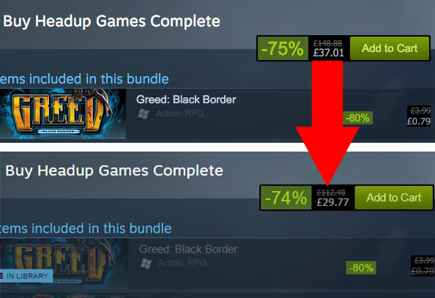
Business Model
Service fee: shared with physicians
Discounts: attracts customers
Bundle Sales
BACKGROUND
SOLUTION
OPPORTUNITY
MILESTONES

