Slide 1
H-BELT
By Zhaoqi Chen, Darsha Muralidharan, and Saul Mezac

Slide 2
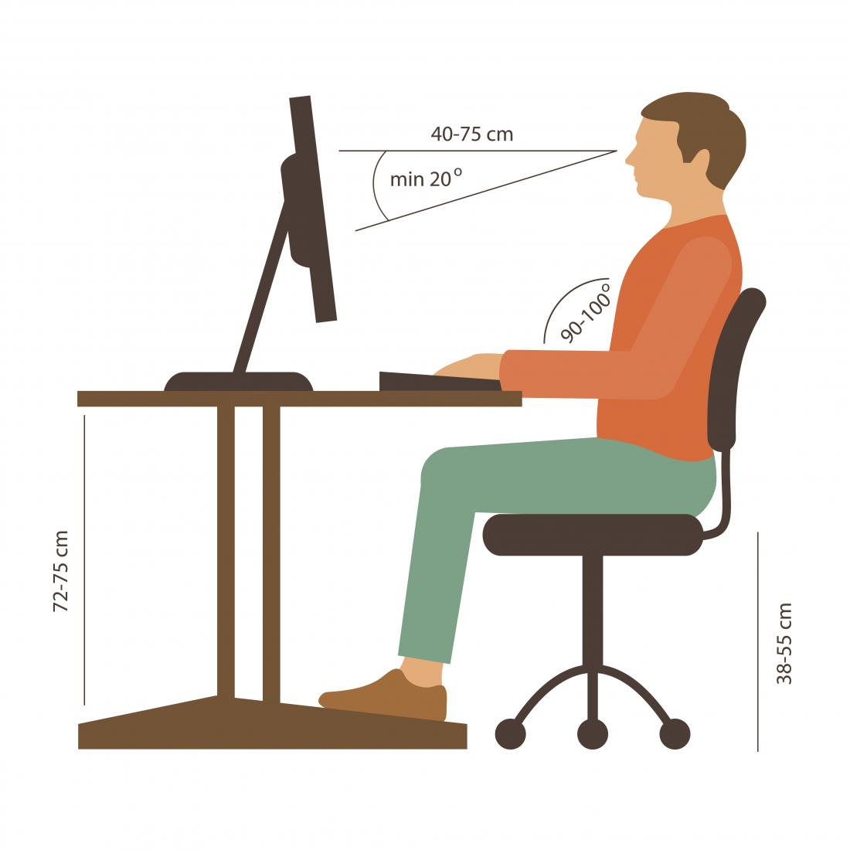
Back Pain
Is it a common problem?
What can we do?

Slide 3
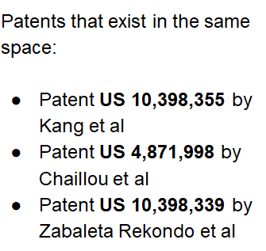
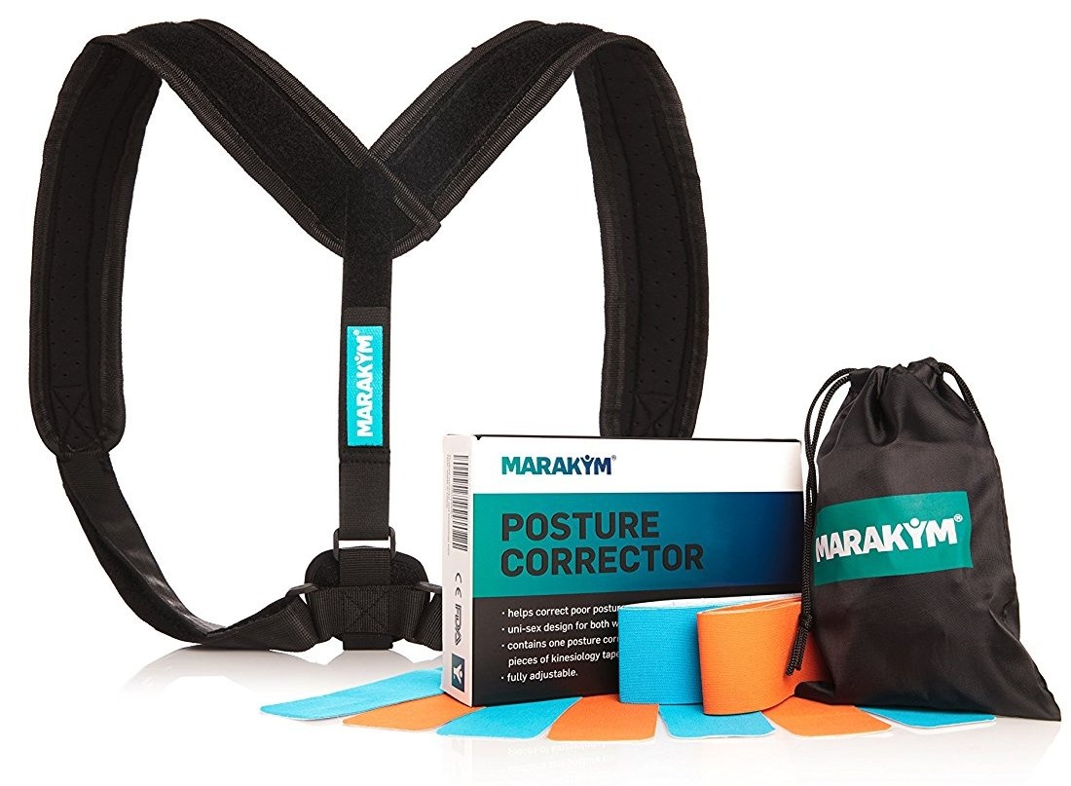
Existing products and patents
Posture Corrector: extra device and uncomfortable
Belt with accelerometer: inaccurate and no reminder
Lean Detector: rely on phone to remind and extra device

Slide 4
Design Overview
2. Smart Clip
1. Smart Buckle
Notes:
We instead use a pressure sensor on the belt to measure when the sitting time
A buzzer would alarm the user every half an hour
We use a clip with inclinometer to measure spine inclination
Along with an accelerometer to measure movements
General biometrics like urination frequency, exercise is also possible by the combination of sensor information

Slide 5
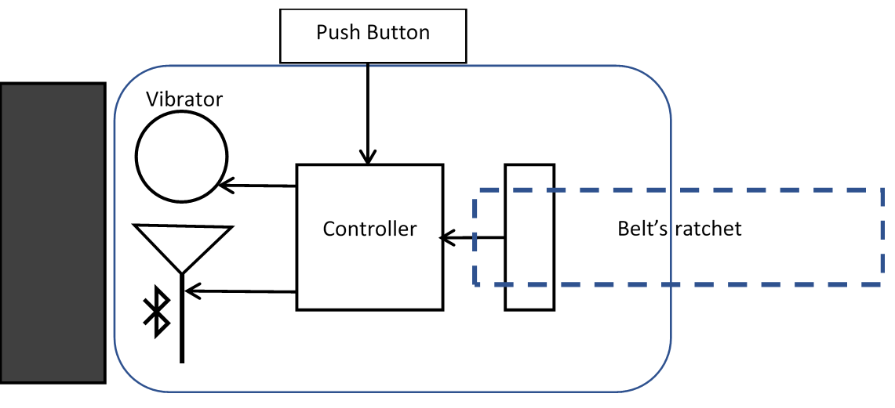
Design: Smart Buckle
Notes:
We instead use a pressure sensor on the belt to measure when the sitting time
A buzzer would alarm the user every half an hour
We use a clip with inclinometer to measure spine inclination
Along with an accelerometer to measure movements
General biometrics like urination frequency, exercise is also possible by the combination of sensor information

Slide 6
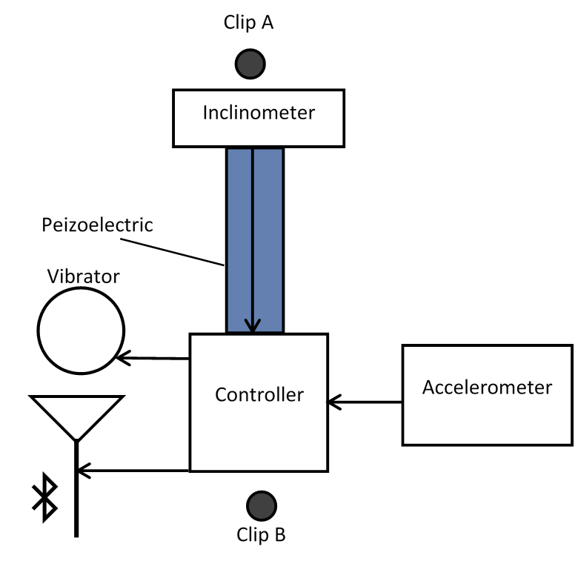
Design: Smart Clip
Notes:
We instead use a pressure sensor on the belt to measure when the sitting time
A buzzer would alarm the user every half an hour
We use a clip with inclinometer to measure spine inclination
Along with an accelerometer to measure movements
General biometrics like urination frequency, exercise is also possible by the combination of sensor information

Slide 7
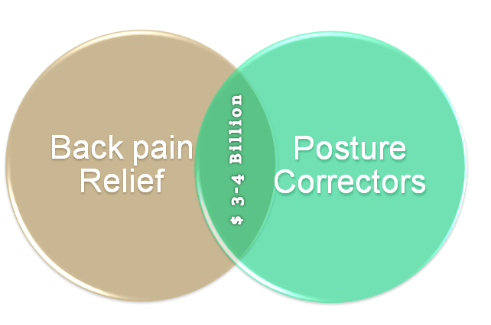
Market
Notes:
We instead use a pressure sensor on the belt to measure when the sitting time
A buzzer would alarm the user every half an hour
We use a clip with inclinometer to measure spine inclination
Along with an accelerometer to measure movements
General biometrics like urination frequency, exercise is also possible by the combination of sensor information

Slide 8
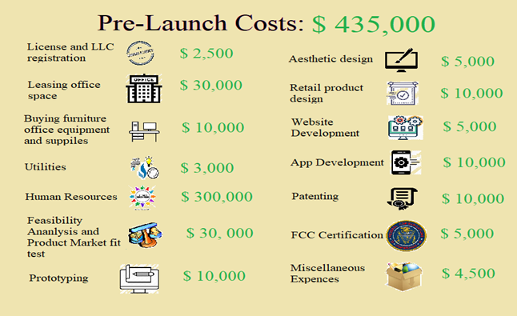
Total Cost: 1.5 Million
Notes:
We instead use a pressure sensor on the belt to measure when the sitting time
A buzzer would alarm the user every half an hour
We use a clip with inclinometer to measure spine inclination
Along with an accelerometer to measure movements
General biometrics like urination frequency, exercise is also possible by the combination of sensor information

Slide 9
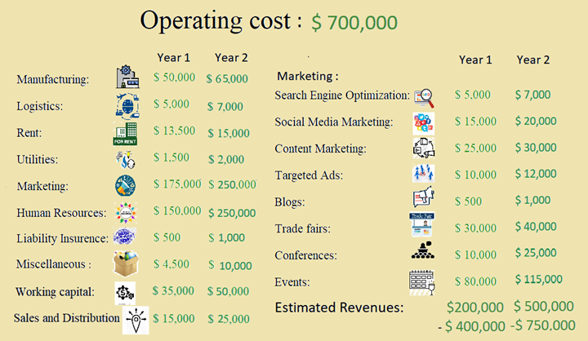
Total Cost: 1.5 Million
Notes:
We instead use a pressure sensor on the belt to measure when the sitting time
A buzzer would alarm the user every half an hour
We use a clip with inclinometer to measure spine inclination
Along with an accelerometer to measure movements
General biometrics like urination frequency, exercise is also possible by the combination of sensor information

Slide 10
OUR TEAM
SAÚL MEZA
M.S.E. Biomedical Engineering
Zhaoqi Chen
M.S.E. Electrical Engineering
Darsha Muralidharan
M.S.E. Biomedical Engineering

