Slide 1
GripTrack
Dimitri Herr, Chang Hwan Choi, Teresa George

Slide 2
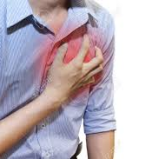
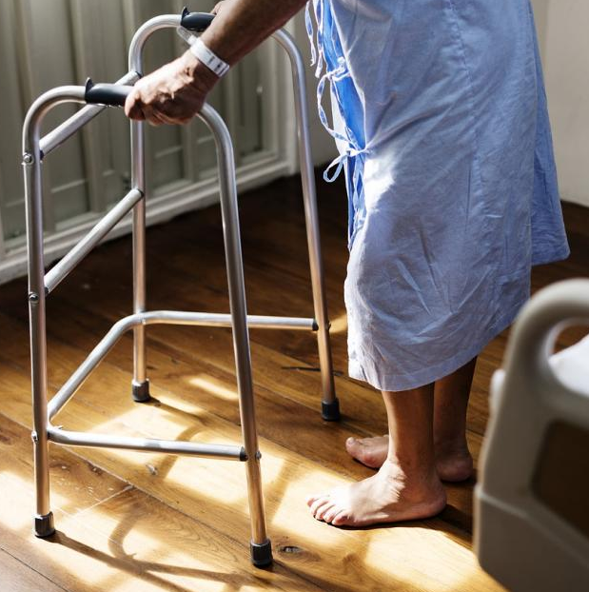
The Problem
Cardiovascular diseases (CVD) account for most old age deaths (1 in every 4 deaths)
1 in 3 Americans over 50 at risk
610,000 CVD deaths in the US per year
Risk for Frailty Syndrome (musculoskeletal deterioration) increases with age
An adult over 64 dies every 19 minutes from accidental falls
Signs of frailty/CVD often caught too late
Exponential increase in treatment costs and mortality rate as disease progresses
Notes:
Frailty cardio vascular stuff

Slide 3
The Problem Need Statement
There is a need for an accurate and simple early warning system capable of tracking the cardiovascular and musculoskeletal health for the elderly population
Notes:
Cardiac stats
“About 610,000 people die of heart disease in the United States every year–that’s 1 in every 4 deaths.”
“the AHA reports that most cases are preventable by early detection and leading a more heart-healthy lifestyle.”
Personal story: My grandma showed up for her routine six month checkup and was told she needed to go straight to the ER to have Triple bypass surgery (ask mom for more details on this)
Frailty stats
“One in four Americans aged 65+ falls each year.”
“Falls are the leading cause of fatal and non-fatal injuries for older Americans.”

Slide 4
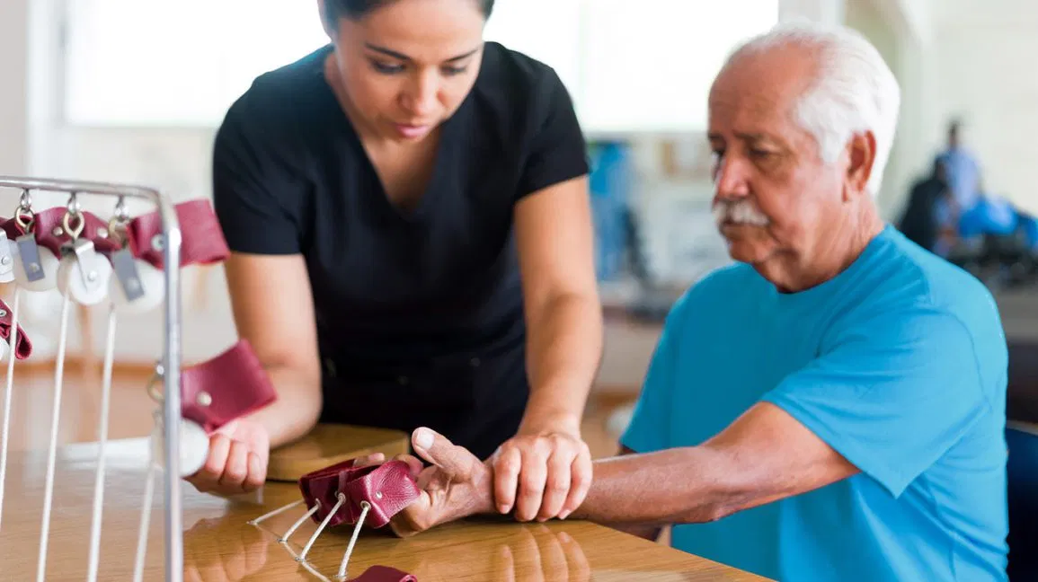
Grip Strength as a Diagnostic Tool
Grip strength assessments can track the progression of:
Cognitive decline
Cardiovascular health
Frailty syndrome
Advantages over other diagnostic metrics (e.g. ECG, BP):
Can track musculoskeletal health
Accurate - Not as prone to errors/noise
Ease of use - Instructions for grip strength assessments very simple
Notes:
Speak out specifics. Explain while the research is very well proven in Cardivascular stuff it is less proven in X, Y, and Z. Grip Strength still new lots of studies still on going. As more studies publish our analytical tool will be able to say more things.

Slide 5
GripTrack: Early Warning Flow Diagram
Portable grip strength monitoring device with the following features:
Monitoring of Grip strength over time on the Grip Track app.
User friendly interface targeted at elderly
Grip strength assessment incorporated as a game
Graphical representation of data over time and analysis sent to care team members

Slide 6
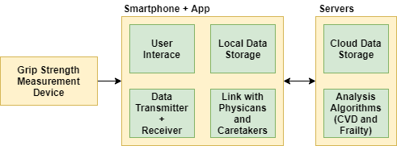
Technical Details
Notes:
TODO take all the details out of the bottom part

Slide 7
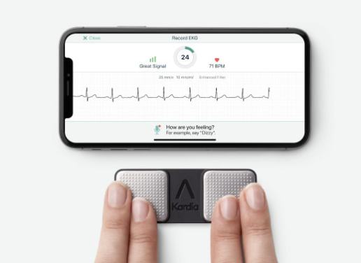
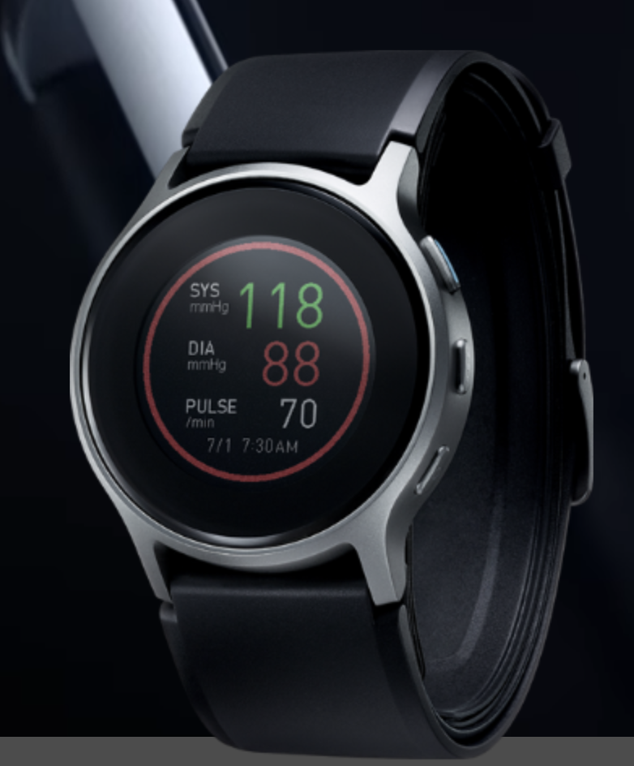
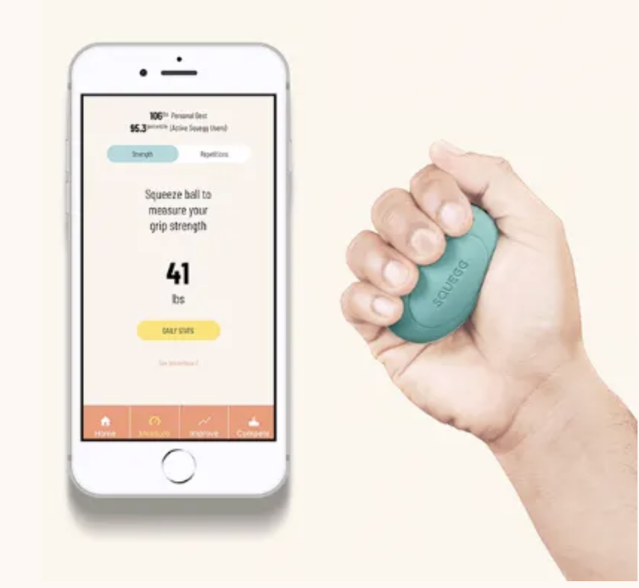
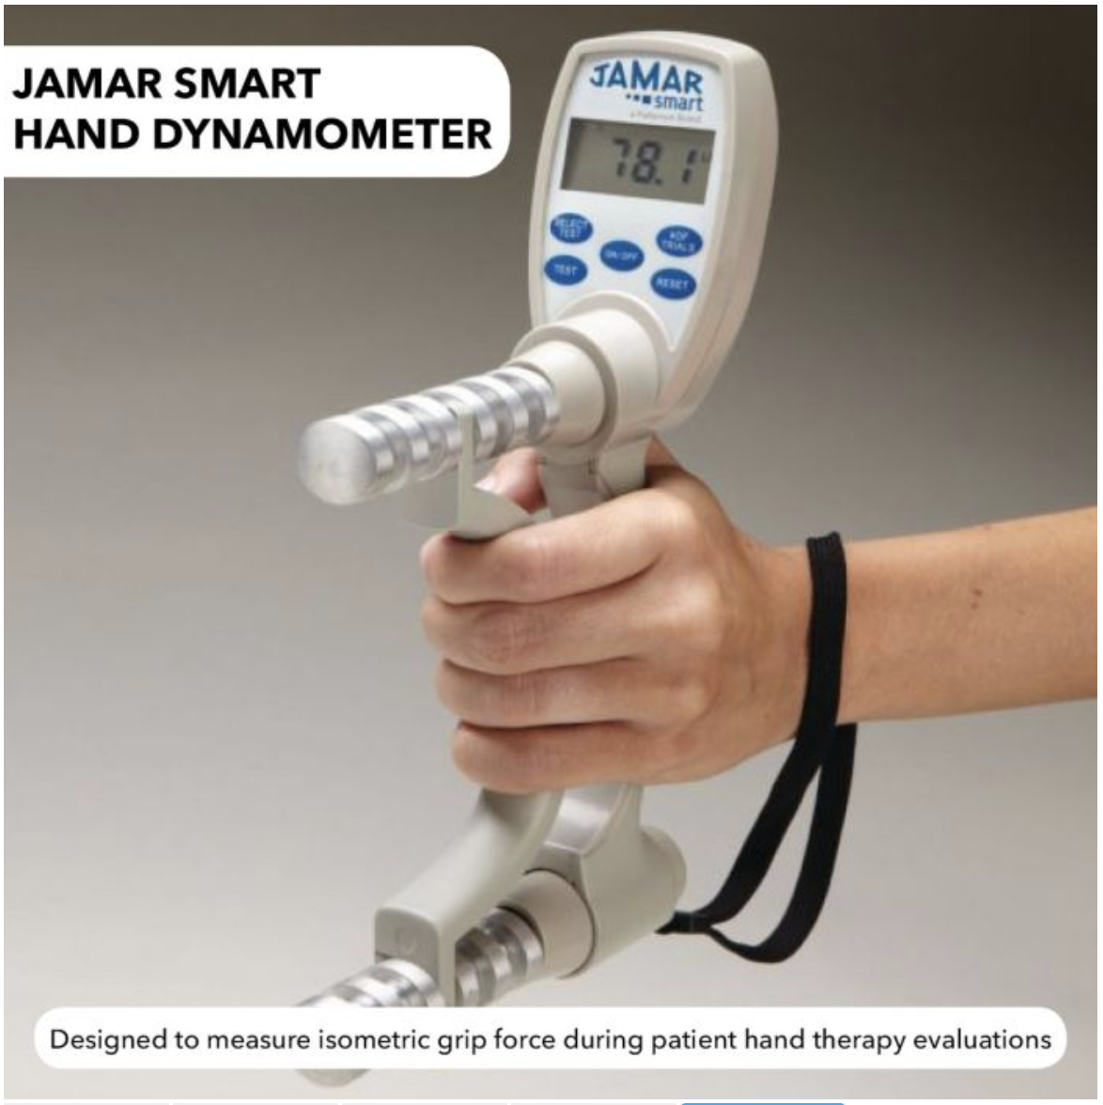
Existing Products and Competitors
AliveCor EKG
1 or 6 lead person EKG with app
Costs $100 or $150 dollars
Can only diagnose cardiovascular problems
Omron Blood Pressure Smart Watch
Smartwatch that can inflate and take blood pressure
Very expensive, costs $500
Blood pressure only
SQUEGG Digital Dynamometer
Grip strength measurement device with app pairment
Costs $40
No health-tracking metrics/tailored towards exercise
Jamar Plus Hand Dynamometer
Grip strength measurement device targeted towards physical therapy
Very expensive, costs $363
Very large includes display panel screen
Notes:
If they can make a handheld EKG for $100 we should really be able to do better than $50 maybe adjust to 40 to match the SQUEGG as basically our hardware is the same but our software will be different

Slide 8
Market Analysis
CVD
121 million Americans Diagnosed with cardiovascular diseases annually.
CVD and stroke account for 14% of health expenditure in 2014-2015.
Total Medical costs for CVD projected to increase to $749 billion in 2035.
Frailty / Falls
Each year, 3 million older people are treated in emergency departments for fall injuries.
In 2015, the total medical costs for falls totaled more than $50 billion
Notes:
Should also include fall statistics here

Slide 9
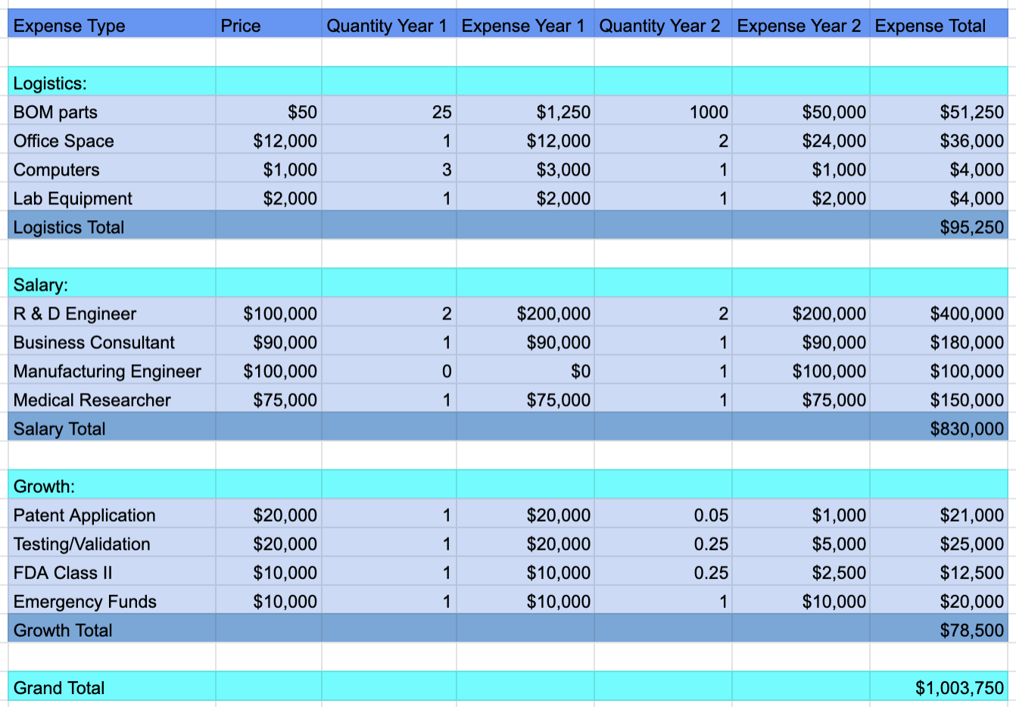
Business Model: Funding for Two Year of Runway

Slide 10
Business Model Pricing Options
Personal Option
For home use (single person)
$50 for GripTrack device
$9 monthly subscription for app (free version available)
Nursing Option
For use at assisted living facilities, nursing homes, hospitals
Supports multiple users
$50 per GripTrack device
Monthly subscription fees scales with capacity of nursing home/ward
10 or less - $40
Up to 50 - $120
Up to 100 - $200
100 or more - $250
Supports all features of paid personal app
Tracks all patients individually
App Version | Free | Paid
Grip strength measurement
Cloud data storage | Only last 7 days
Personalized health report
Free device replacement
Connection with doctor

Slide 11
Market Penetration Expectation (1st year):
Personal Option:We are considering 140,000 persons:0.25% of 56 million:Persons above age 65 in USA.
Assuming 90,000 persons opt for free subscription and 50,000 persons opt for paid subscription.
Nursing Option: We are considering 2% of total Nursing homes in the US (2% 15,600:312) and 2% of assisted living facilities in the US (2% of 28,900:578)
Total Revenue: $12.46 million

Slide 12
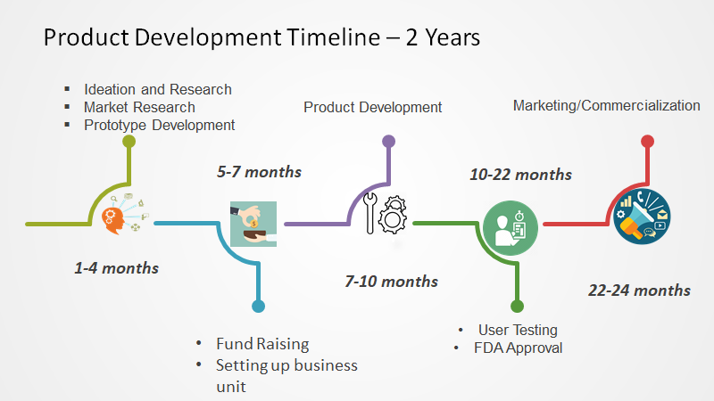
2 year Timeline:

Slide 13
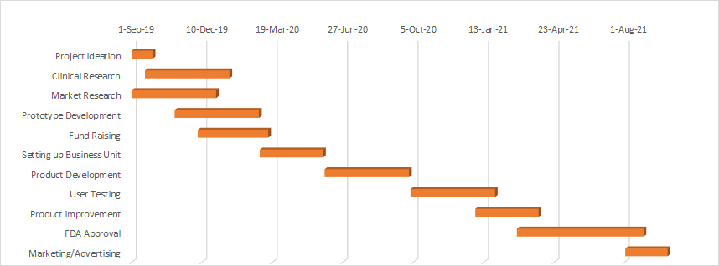
Gantt Chart

Slide 14
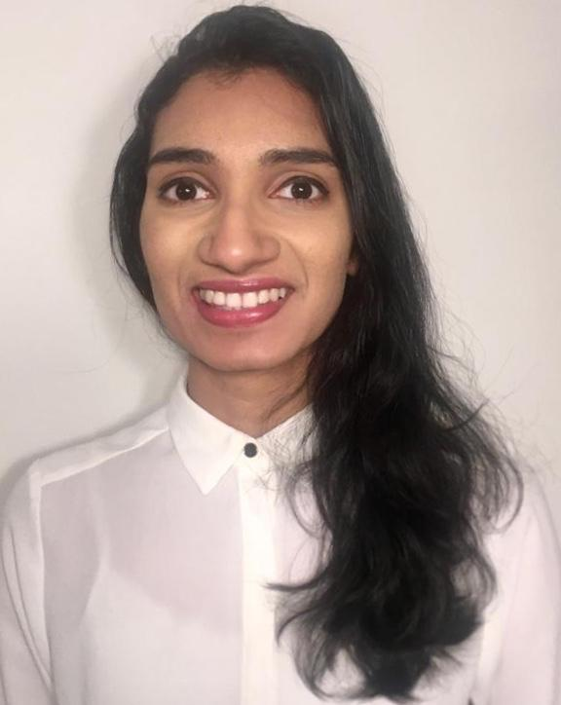
Meet the GripTrack Team
Electrical Engineering Masters Student graduating in December 2019.
Focus on Systems Integration and Signal Processing
Previous work experience: Nikon Research Corporation of America, Cadence Design Systems
Electrical Engineering Masters Student graduating in December 2019.
Focus on Embedded Systems and Signal Processing
Previous work experience: Vasoptic Medical, SINAPSE Institute for Neurotechnology
Biomedical Engineering Masters Student graduating in May 2020.
Focus biomedical instrumentation and medical devices
Previous work experience: Emerson Automation solutions,Malone center for engineering in healthcare.

