Slide 1
Blue Light Technologies
See the world on your own terms
December
2019
Notes:
Blue Light Technologies -- See the world on your own terms

Slide 2
AGENDA
Founding Team
Background
Market Information
Problem
Solution
Competition
Current Patents
BLT Product
BLT in Action
Business Model
Expenses
Conclusion
Notes:
We will initially talk about background and market information and then address the problem, solution, and competition. Finally, we will introduce the product and the business model. We will end with the conclusion.

Slide 3
FOUNDING TEAM
Arjun Vachhani – Founder
Johns Hopkins University B. S. Biomedical Engineering, 2019
Notes:
I am founder with a well qualifying degree in Biomedical engineering from Johns Hopkins University to design a biomedical instrument and make it a successful business.

Slide 4
BACKGROUND
While there are benefits to blue light exposure, they are difficult to quantify without measurement
Blue light is omnipresent in a digital world, and overexposure has significant health impacts
Key role in circadian rhythm and cortisol regulation, timing and duration of exposure is key^{1,2}
Night modes reduce only a fraction of blue light exposure – many sources of blue light
Many occupations requires to turn off “night mode” – easy to lose track of exposure
Constant exposure to 400-495 nm blue light has significant ocular impacts³
Over exposure to blue light causes
Eye strain
Eye fatigue
Blurred vision
Macular degeneration
Dry eyes
Notes:
Blue light in the range of 400 - 495 nm has some health benefits like circadian rhythm and cortisol regulation. In this digital age more people are exposed to blue light by electronic devices and protection in laptops and phones only reduces some light and some professions require turning off night modes. Over exposure to blue light can cause health issues like Macular degeneration, Eye fatigue, blurred vision, eye strain and dry eyes.
https://www.ncbi.nlm.nih.gov/pubmed/31646762
https://www.ncbi.nlm.nih.gov/pubmed/30556352
https://www.ncbi.nlm.nih.gov/pmc/articles/PMC6288536/

Slide 5
MARKET INFORMATION
The most common remedy to this problem is blue light blocking glasses – an analog, static, tinted solution
90% of Americans use a digital display for 2 or more hours each day ¹
65% of Americans report experiencing symptoms of digital eye strain ¹
35 % Eye strain
25% Headache
25% Blurred vision
24% dry eyes
73% of adults under 30 experience these symptoms, suggesting a generational trend ¹
Young children are more susceptible to blue light symptoms because their eyes are more transparent ¹
8.4 million people worldwide have age-related macular degeneration (AMD). Treatment costs $8000+ per year. ²
Global market size of blue light blocking glasses will increase to $ 27 million by 2024, from $ 18 million today ³
Notes:
As 90% of Americans are exposed to digital displays for 2 hrs or more and 65% of the population experiences digital eye strains, there is a large market that needs to be addressed. Young people are especially more susceptible. There are 8.4 million people who spend more than $8000 per year on macular degeneration treatment and global market for blue light blocking glasses will climb to $27 million in 2024 from $18 million today. So, there is a big market with opportunity to make money.
https://www.weforum.org/agenda/2016/09/staring-down-the-dangers-of-the-digital-workplace/
https://www.thelancet.com/journals/lancet/article/PIIS0140-6736(18)32291-8/fulltext
https://www.marketwatch.com/press-release/blue-light-blocking-glasses-market-size-will-grow-at-83-cagr-to-exceed-27-million-usd-by-2024-2019-05-07

Slide 6
PROBLEM
An increasingly digital world increases the body’s exposure to harmful blue light
Blue light is emitted in different quantities from a variety of sources
If you are unable to track and reduce exposure over time, it can cause short term and long-term damage to your eyes
Notes:
The problem is that with lot of digital devices in the world today people can get significant exposure to harmful blue light and may not be able to prevent it if they do not monitor their exposure.

Slide 7
SOLUTION
BLT shields eyes from blue light exposure while keeping user in control
Our glasses enable you to monitor your total exposure to blue light from various sources
Keeps you informed on how long and when you were exposed to blue light
With available data
Identify blue light sources user is exposed to
Control all users personal blue light emitting devices when overexposure is detected
In the future, with advances in lens technology, can dynamically adjust lens polarization when overexposure to blue light is detected, with the option to manually override for color-sensitive work
Notes:
Our solution consists of collecting and monitoring user’s total exposure to blue light from various sources using eyeglasses. Using this very valuable data we let the user be in control on how they want to prevent blue light exposure. This data can also help them figure out various blue light sources that they are exposed to and in the future, it will help our company grow by introducing follow on products that take advantage of this data.

Slide 8
COMPETITION
Company | Starting Price | Features
LensCrafters¹ | $50 additional | Blue light blocking lens coating – add on after purchasing frames/ lenses
Felix Gray² | $95 | UV non-tinted antiglare professional glasses that block higher range of blue light spectrum
Warby Parker³ | $50 additional | Blue light blocking lens coating – add on after purchasing frames/ lenses (total cost starts at $150)
Screen Monitor | Free | Tracks screen time on PC and phones, and indirectly calculates blue light exposure
Night Mode | Free | Adapts PC and phone colors according to time of the day to limit blue light exposure at night
Most blue light blocking glasses are static and have tinted lenses and are somewhat expensive.
Most blue-light reduction exposure technologies are free, but only work on a single device and are time (not exposure) based.
Does not provide accurate exposure data and user not in full control
Notes:
There are various competitors with static solutions like eye glasses which are somewhat expensive. There are free products that are time based and work only on single device. None on them provide actual exposure data and so are not accurate. They also do not keep the user at the center and in control on how to reduce exposure.
1) https://www.lenscrafters.com/
2) https://shopfelixgray.com/
3) https://www.warbyparker.com/

Slide 9
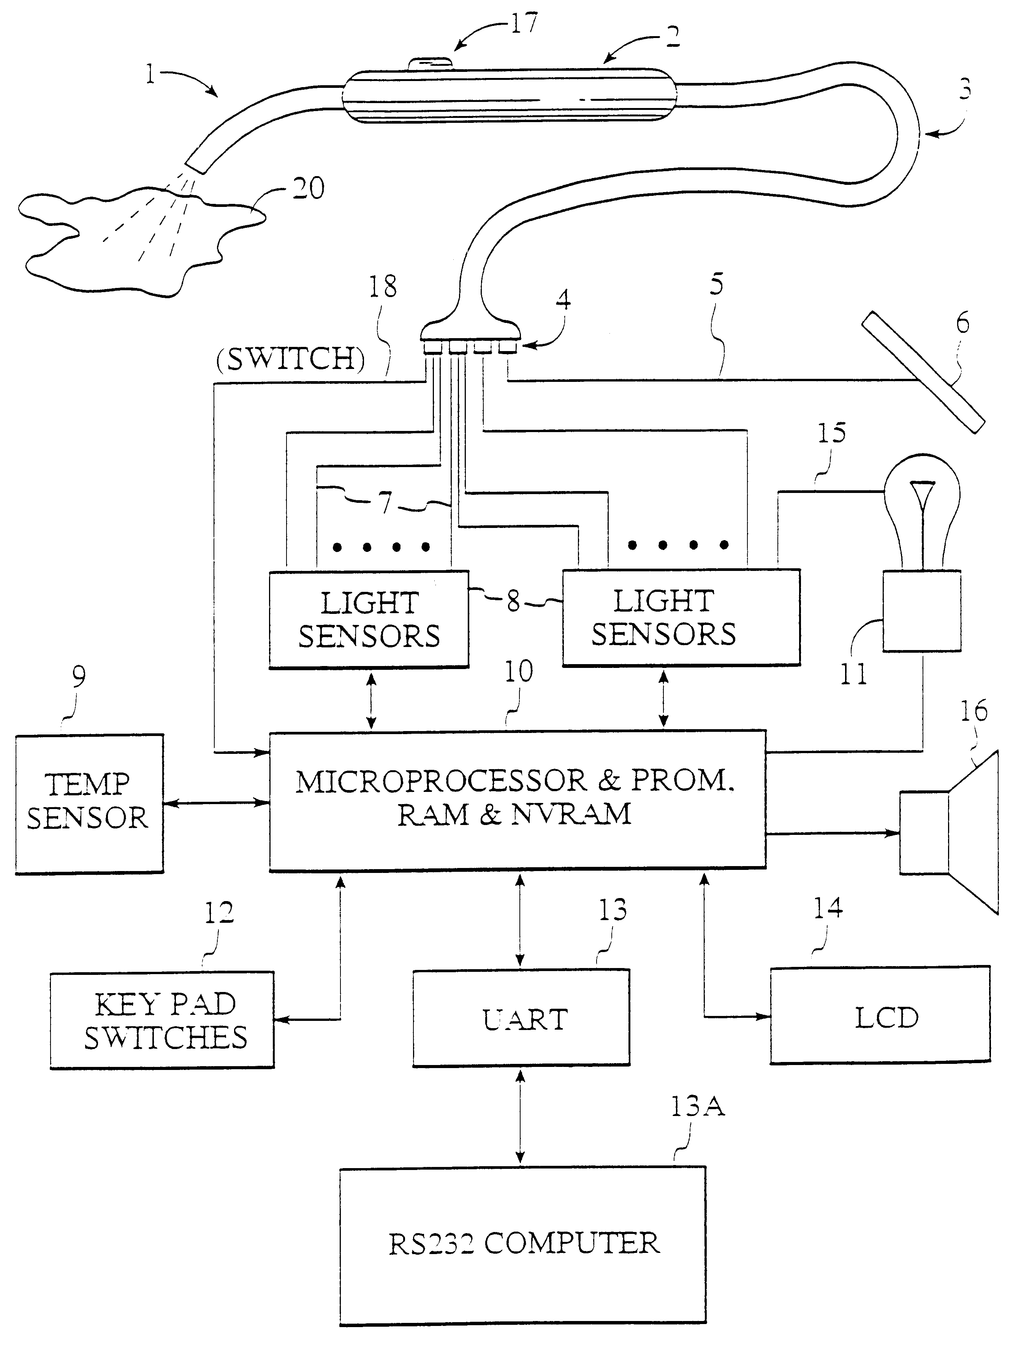
CURRENT PATENTS
Patents on light measuring devices (expired)
US5926262A - Apparatus and method for measuring optical characteristics of an object
Some Patents on blue light filtering lenses
US20160195736A1 - Blue light filtering lenses
US6955430B2 - Blue light blocking lens
Our solution does not violate any existing patents.
Notes:
There is one patent showing how to reliably take light measurements to identify objects but this patent has expired. There are many patents on blue light filtering lenses and some of them are listed here. Our solution does not violate any existing patents.
US5926262A - Devices and methods are provided for measuring the color and other optical characteristics of objects, reliably and with minimal problems of height and angular dependence.(1997-01-02 Priority to PCT/US1997/000126) (2019-11-29 Application status is Expired - Lifetime)

Slide 10
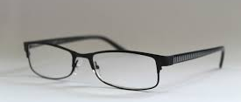
BLT PRODUCT DESIGN
Blue Light Sensor
Microcontroller and Bluetooth transmitter
electronics
Battery
10
This Photo by Unknown Author is licensed under CC BY-SA-NC
Notes:
Our product consists of a good looking eye glasses frame available with blue light sensor in the center and the electronics and battery at the ends. Next slide shows diagram of our glasses in action.

Slide 11
BLT IN ACTION
1
2
3
4
5
400-495 nm light source
BlueLight
sensor on
BLT Glasses
Bluetooth data transmission
Computer
processes data
using user
information
Information
displayed to
user. Action taken at user’s choice
Examples: Control all user devices, Identify blue light sources, risk of eye damage :
Notes:
As you can see our BLT glasses will monitor blue light exposure in 400-495 nm range and send that information via Bluetooth to computer or smart phone. This valuable data is then processed and stored and can be used to give user control and options to reduce blue light exposure. The user can set option to automatically change settings on all of their devices to reduce blue light exposure. The data can also point out when and for how long user was exposed to blue light, helping to identify blue light devices. Data can give user’s past history and can average out blue light exposure in past helping identify risk of eye damage. These are some of the examples from vast amount of options that we have to use this data.

Slide 12
Sample Screen
User: Arjun
Total Blue Light Exposure – 4 hrs (Overexposure detected)
Do you want to block blue light on all your devices? Yes No
View other options
Notes:
Here is a sample screen which shows overexposure detected and user having various options to take action.

Slide 13
BUSINESS MODEL
Inform and keep the user in control
Additional electronics (~$6)- can sell at competitive price.
Tesla Model: Initial cost high due to low volume. Reducing manufacturing costs through economies of scale and automation. Future batches more affordable
Partnerships to increase sales and educate public:
Corporate benefits programs – Reduces liability and reduces health insurance cost
Schools and Universities – Education discount program as school-aged and university dependents are more at risk
Insurance plans to include as part of benefits package. Preventive measure to avoid future eye problems.
Notes:
Our business model is simple. Our low cost on electronics compared to total cost of eye glass with help us sell at competitive price. We will use Tesla Model to fund and reduce manufacturing cost and improve profits in future. We will put strong emphasis on partnership with various entity and use it to increase sales and educate public about this issue of blue light health impact.

Slide 14
EXPENSES
Projected expenditures
Item | First year | Second Year
Product Development ( R&D) | $150,000 | $175,000
IP, Legal Fees | $50,000 | $50,000
Marketing and Fulfillment | $100,000 | $125,000
App Development & Data Management | $100,000 | $125,000
Customer, App, Fulfillment Support (Staff) | $75,000 | $100,000
Total | $475,000 | $575,000
Notes:
We will have expenses of about $500K every year to develop, sell and support our product as detailed in the table.

Slide 15
CONCLUSION
THANK YOU!
Millions of Americans take the time to invest in their sight as it is, why not add value to their vision plan?
With an increasing aging population, there is a higher emphasis on retaining health and wellness more than ever
We are in the midst of a digital health revolution where data is being leveraged to improve outcomes of many preventable diseases
Technology has the potential to evoke data-driven behavior change across many non communicable diseases already – leveraging it to prevent eye issues has the potential to alleviate many of the symptoms related to aging
Our product can play a big part in helping people to do above on their own terms.
Notes:
Digital age has created the problem of blue light exposure, but people have high awareness about their health and are motivated to do something with the vast data available to improve their health. Our product can play a big part in helping people to do exactly that on their own terms.

